Slide 1
Mega Projects Guidelines Training
Course Objectives
Van Walling, PE
Walling Consulting Services
Gary Whited, PE
Construction and Materials Support Center
UW-Madison

Slide 2
Welcome and Introductions
Please provide…
Name
Title
Office
Mega project role
Meaningful takeaway from today’s training

Slide 3
Importance of Mega Projects
Comments from Secretary Gottlieb
Click on photo for video clip:

Slide 4
Mega Project Guidelines Objectives
Mega Project Team convened in 2011
Team’s Charge was to communicate:
Existing processes
Organizational structure
Best Practices
Appropriate level of effort
And promote consistency in management and
oversight of Mega Projects
Team developed guidance and that is found in the
Mega Projects Guidelines
Notes:
Section 7: Project Matrix
Section 9: Management Systems
Section 10: Budget Estimation & Management
Section 11: Change Management
Section 12: Management Expectations
Section 13: Best Practices

Slide 5
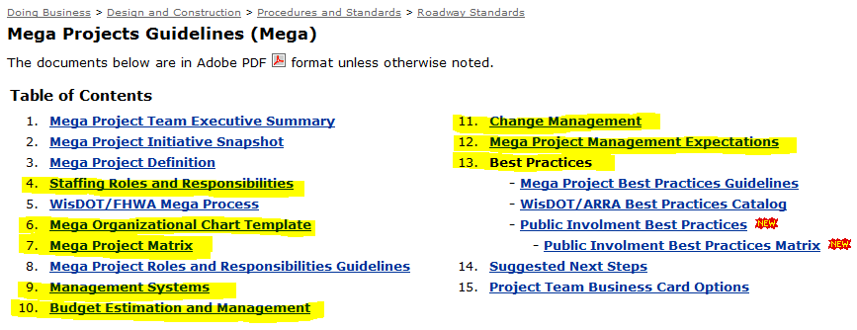
Training Topic Areas
http://roadwaystandards.dot.wi.gov/standards/mega/index.htm
Notes:
Section 7: Project Matrix
Section 9: Management Systems
Section 10: Budget Estimation & Management
Section 11: Change Management
Section 12: Management Expectations
Section 13: Best Practices

Slide 6
Training Objectives
Exposure to the Guidelines
Explain content of selected sections
Identify Best Practices
Share experiences from past Mega Projects
Notes:
Section 7: Project Matrix
Section 9: Management Systems
Section 10: Budget Estimation & Management
Section 11: Change Management
Section 12: Management Expectations
Section 13: Best Practices

Slide 7
Characteristics of Mega Projects
What makes a project mega?
Notes:
Large group exercise where participants are asked to identify characteristics of mega/major project. Facilitators will record answers on a flip chart.

Slide 8
Mega projects are not business as usual !
Mega projects are large.
Avg. 3R/BB Project is $2 M
Avg. Major is $145 M
N-S Freeway Plan Set: 10,109 Sheets
Marquette Int. Specials: 883 Sheets
Zoo FEIS Document: 600 Pages

Slide 9
Mega projects are not business as usual !
Mega projects are fast-paced.
USH 41: 65 Progress Estimates ≥ $1,000,000
Largest: $4,069,632
N-S: Largest Progress Estimate: $9,200,000
USH 41: 351 RFI’s (2012); 1-day turnaround
4,485 Documents sent/received (2012)
N-S : 418 Contract Mods processed
4,116 Issues dealt with

Slide 10
Mega projects are not business as usual !
Ryan’s Rule of Times 10 for Mega’s

Slide 11
Mega projects are not business as usual !
Mega projects are complex to manage.
Technical
Technical
Schedule
Cost
SCOPE
SCOPE
Schedule
Cost
Financing
Context

Slide 12
Mega projects are not business as usual!
Mega projects require managing relationships.
Project Team
Region & Division
Management
Region support staff
Statewide Bureaus
FHWA
Regulatory Agencies

Slide 13
Mega projects are not business as usual!
Mega projects require managing relationships.

Slide 14
Mega projects are not business as usual!
Mega projects require managing resources.
Staff
Facilities
IT
Equipment

Slide 15
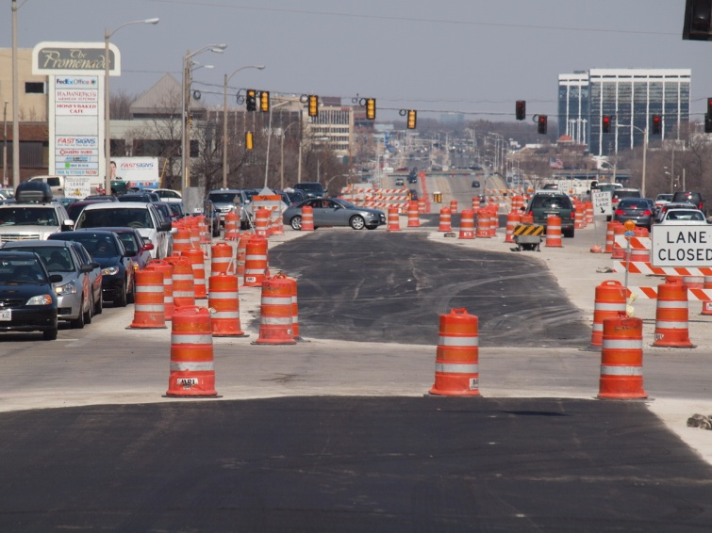
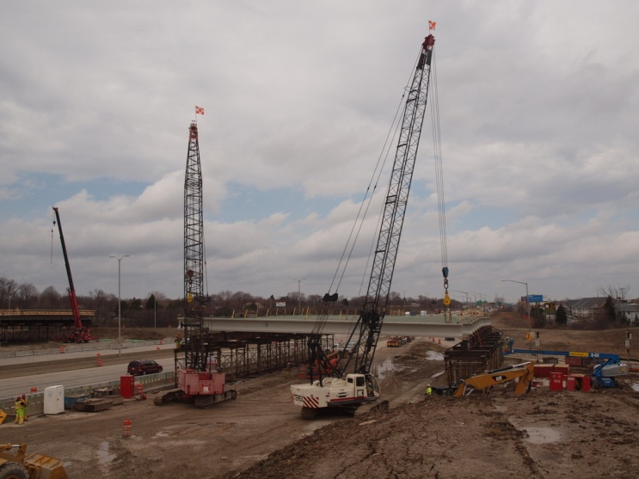
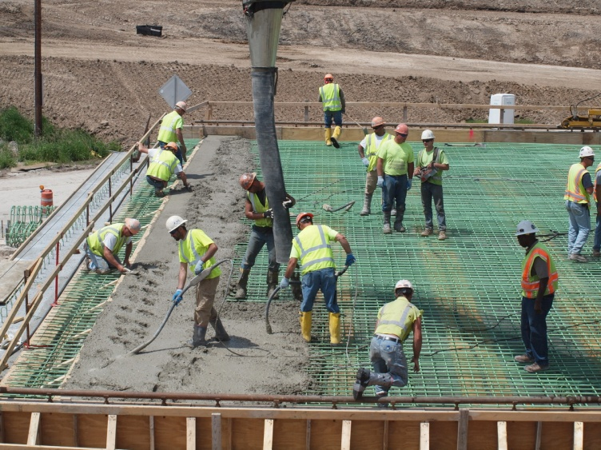
Mega projects are not business as usual !
Mega projects are high risk.
Notes:
Picture from Marquette, show monitoring tools for cost and design, OCIP?

Slide 16
Mega projects are not business as usual!

Slide 17
Delivering a Mega Project
Identify the biggest challenges within the following categories (each group is assigned one category)
Identify potential solutions to address the challenge.
a) Budget b) Schedule
c) Experience/Expertise d) Technical
e) Staffing/Resources f) Teamwork
g) Communication

Slide 18
Delivering a Mega Project
Key takeaways:
Each project is unique
Need for increased level of team work and trust
Emphasis on problem solving
Ownership of the project by team
Importance of attitude

Slide 19
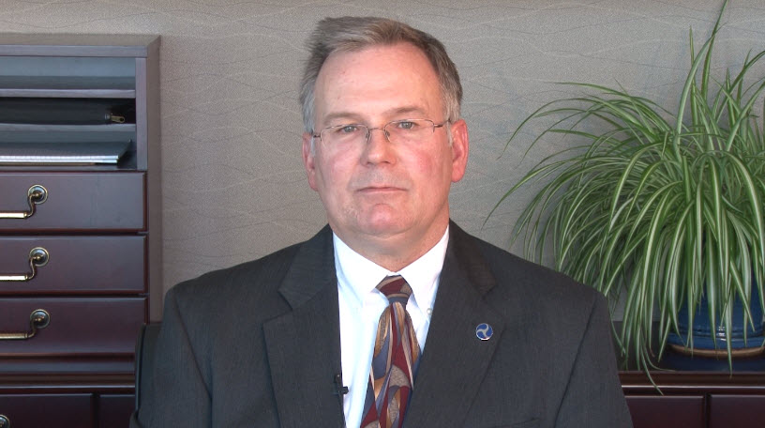
Delivering a Mega Project
Comments from George Poirier, FHWA
Click on photo for video clip:

Slide 20
Break
Please return at:
Notes:
Box lunch to be provided so participants remain on sight and have chance interact with each other.

Slide 21
Resources for Mega Projects
Wisconsin DOT
Mega Projects Guidelines on the Web
Mega Project Matrix (Section 7)
Scoping tools
Cost Estimating Tool (Section 10)
Statewide Bureau Resources
Outlook calendar
Quarterly snapshot
FHWA
Project Delivery Webpage

Slide 22
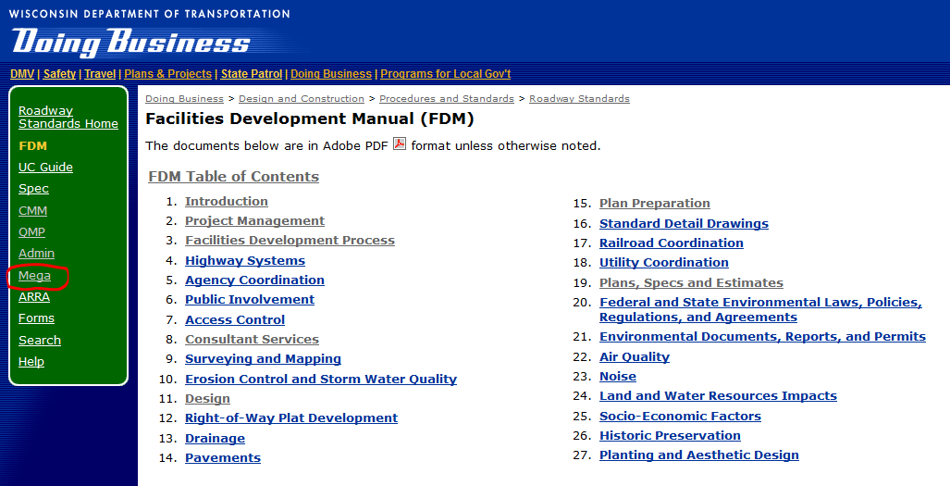
Mega Projects Guidelines
http://roadwaystandards.dot.wi.gov/standards/mega/index.htm
Notes:
Section 7: Project Matrix
Section 9: Management Systems
Section 10: Budget Estimation & Management
Section 11: Change Management
Section 12: Management Expectations
Section 13: Best Practices

Slide 23
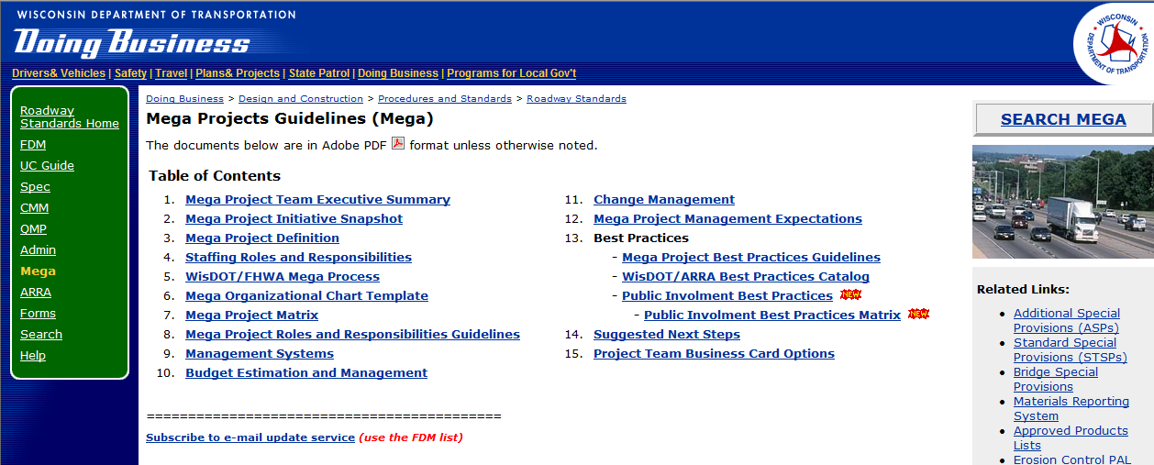
Mega Projects Guidelines on the Web
http://roadwaystandards.dot.wi.gov/standards/mega/index.htm

Slide 24
Mega Project Matrix (Section 7)

Slide 25
FDM Project Scoping Checklist

Slide 26
I-39/90 Scoping Spreadsheet
Construction ID |  | 1005-10-71 | 1005-10-72 | 1005-10-73 | 1005-10-74 | 1005-10-75 |  | 1005-10-76 | 1005-10-77 | 1005-10-78
Project Description |  | Rock River Bridges | 2.3 miles ML paving, including STH 59 Interchange |  | Overpasses @ Goede Rd | Overpass @ Manogue Rd | Alt Route | 3 Miles ML paving & noise walls | 2 miles ML paving, include USH 14 & STH 26 intrchngs & noise walls | 6.1 miles ML paving
PS&E Date |  | May-15 |  | Aug-13 | Aug-14 |  | Nov-14 | Aug-16 |  | May-17
Design Engineering Services Contract |  | #2 |  |  |  |  |  | #3
A. | DESIGN REPORTS
N | Concept Definition Report
Y | Design Study Report (4 updates and 3 new) | Update |  | Update | New | New | New | Update |  | Update
Y | Pavement Type Selection Report (7 new) | New |  | New | New | New | New | New |  | New
Y | Exception to Design Standards Report (1 update in B) |  |  |  |  |  |  | Update
Y | Encroachment Report (1 update in B) |  |  |  |  |  |  | Update
Y | Interchange Access Justification Reports (3 updates and 1 new) |  | Update |  |  |  |  |  | 2 updates | New (rest area ramps)
N | Design Criteria Report
N | Design Recommendation Reports
N | Hydraulic Analysis Report
N | Existing Conditions Report
N | Other reports
B. | ENVIRONMENTAL DOCUMENTATION
N | Environmental Assessments
N | Environmental Impact Statements
Y | ER |  |  |  |  |  | New
Y | Design Refinement Memo (1 update for A and new for B) | Update |  |  |  |  |  | New

Slide 27
Cost Estimating Tool (Section 10)

Slide 28
Statewide Bureau Resources

Slide 29
Outlook Calendar for Mega Projects
Mega Project Meetings scheduled on Outlook
Agendas with desired decisions identified
Meetings scheduled by Project Teams

Slide 30
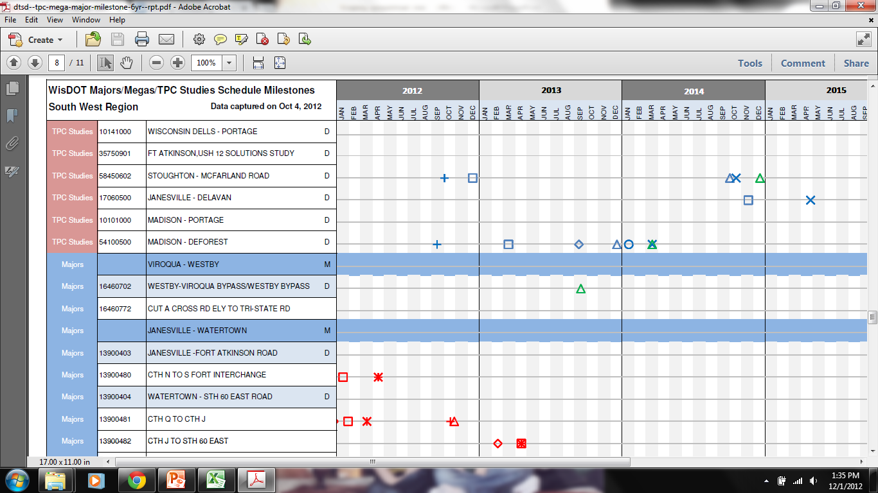
Mega Projects Quarterly Snapshot

Slide 31
FHWA Website
http://www.fhwa.dot.gov/ipd/project_delivery/tools_programs/project_management_plans/guidance.htm

Slide 32
Management Systems for Mega Projects
Management and Reporting (Section 9)
Change Management (Section 11)
Management Expectations (Section 12)

Slide 33
Management and Reporting (Section 9)
Federal level
Department level
Region and bureau level
DBE and Small Business Responsibilities
Title VI Responsibilities

Slide 34
Federal Level
Projects receiving federal financial assistance with estimated total cost >$500M require:
Project Management Plan - documents the procedures and processes that manage the scope, costs, schedules, quality and applicable federal requirements
Annual Financial Plan - based on detailed estimates and assumptions of future increases in the cost to complete the project
Simplified federal financial plan required for projects with estimated total cost between $100M and $500M

Slide 35
Department Level
Oversight Team meetings - Mega Projects report on a monthly basis to the Department’s Oversight Team to share information on:
budget
schedule
work completed and planned
significant issues and risks
public involvement and legislative communication and coordination
disadvantaged business enterprise and labor initiatives

Slide 36
Department Level
Division Mega and Major Projects Team meetings - Region Directors, Bureau Directors, Administrator’s Office, Mega and Major Project Development Chiefs, DTIM BSHP and BTLR Directors, and FHWA meet monthly to address:
project issues and risks
schedule issues and priorities
resource issues and priorities
high level policy decisions
best practices and successful project components
areas for collaboration
consistent messaging on division Mega / Major project schedules, budgets, quality, and safe product use
technology transfer

Slide 37
Region, Bureau and Team Management Level
A team working on a Mega Project will typically have multiple daily or weekly meetings focused on immediate project needs along with issues and risks.
The project team should hold a Change Management and Progress Meeting on a bi-weekly to monthly basis. Topics covered at the meeting should cover components required in the Project Management Plan.

Slide 38
Region, Bureau and Team Management Level
Reports that Project Team should utilize:
Executive summary development for Oversight Committee
Activities and deliverables
Issues/action items
Schedule
Cost
Quality
Other status reports, such as DBE/minority participation and contractor safety

Slide 39
Region, Bureau and Team Management Level
Project and Program Management Controls that Project Team should utilize:
Risk management plan
Scope management plan
Scheduling software
Cost tracking software
Project metrics
Contracting strategies (new and innovative)
Value engineering, value analysis, constructability reviews
Contractor outreach meetings
Partnering
Change order/extra work order procedures
Claims management procedure
Other programs, such as Owner Controlled Insurance Programs (OCIP)

Slide 40
DBE and Small Business Responsibilities, Management, and Reporting
The Department has federal and state responsibilities on all of its improvement program projects to fulfill DBE and SBE responsibilities
The Office of Business Opportunity & Equity Compliance (OBOEC) in DTSD oversees and manages these responsibilities

Slide 41
DBE and Small Business Responsibilities, Management, and Reporting
OBOEC carries out a number of ongoing responsibilities for the Department that cover all programs. These include:
Inclusive DBE goal setting
DBE firm pre-assessment
Encouraging formalized partnering relationships
Bullseye marketing strategy
Strategies for supplemental DBE contracting opportunities
Outreach to lateral certifying agencies
Structured networking for primes and subs
DBE contracting update
DBE certification workshops
Expedited DBE certification
Civil Rights and Compliance Tracking System (CRCS)
Development and inclusion of contract specifications
Training Workshops

Slide 42
Title VI Responsibilities Management and Reporting
Title VI assures that no person in the United States shall on the grounds of race, color, disability or national origin be excluded from participation in, be denied the benefits of, or be subjected to discrimination under any program or activity receiving federal financial assistance.
The Department has federal Title VI obligations on mega projects, major projects, and high-profile projects. The Department’s Title VI Program assures compliance throughout the various stages of each individual federally-funded and state-funded project:
Planning
Special, Economic and Environmental Effects (SEE)
Project Development
Right-of-Way
Construction

Slide 43
Lunch
Please return at 12:30
Notes:
Box lunch to be provided so participants remain on sight and have chance interact with each other.

Slide 44
Management Systems for Mega Projects
Management and Reporting (Section 9)
Change Management (Section 11)
Management Expectations (Section 12)

Slide 45
Mega Project Change Management (Section 11)
Change management is required and is to utilize the process outlined in this section.
Describes the change management process
for the different phases of project delivery
Identifies the level of decision making authority, frequency of reporting, review committee make up, and gives examples

Slide 46
Mega Project Change Management

Slide 47
Mega Project Change Management
Change Management is a proactive process of tracking and administering changes during delivery of a project.
It is done to minimize the consequences of changes and enable approved changes with minimal disruption.

Slide 48
Mega Project Change Management
Change Management protects you and your project from changes that can damage it.
Big changes that can be major and have serious impact.
Small step-by-step changes that gradually add up.

Slide 49
Mega Project Change Management
Things change on every project!
Changes that regard the final product
Changes that regard the time required
Changes that regard the resources needed
The key is to manage and control it.

Slide 50
Mega Project Change Management
You need to analyze the identified changes.
Who needs the change
What is to be changed and why
How important is the change to the project
What will happen to the project if you make the change

Slide 51
Mega Project Change Management Tools/BP’s
Change Management Reports
Tracking overruns/underruns
Cost to complete estimates
Project level trend reports
Top 10 issue lists
Top 10 risk lists

Slide 52
Mega Project Change Management Tools/BP’s
Construction Change Management starts in the
design phase.

Slide 53
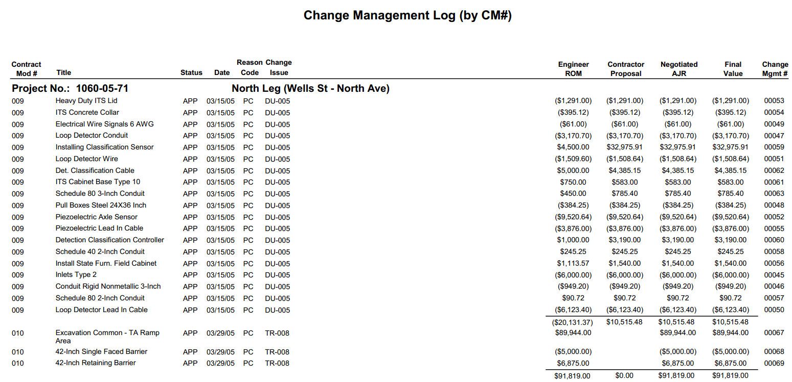
Mega Project Change Management Tools/BP’s

Slide 54
Mega Project Change Management Tools/BP’s

Slide 55
Mega Project Change Management Tools/BP’s

Slide 56
Mega Project Change Management Tools/BP’s

Slide 57
Mega Project Change Management Tools/BP’s

Slide 58
Mega Project Change Management Tools/BP’s

Slide 59
Mega Project Change Management Tools/BP’s

Slide 60
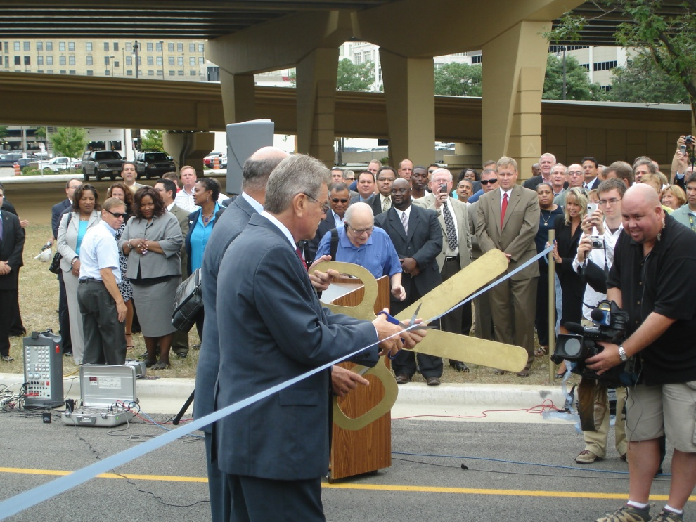
Mega Project Management Expectations (Section 12)
The project is expected to be a success.

Slide 61
Mega Project Management Expectations
That there is shared success within WisDOT.

Slide 62
Mega Project Management Expectations
Project, Region and SWB managers are
responsible for setting the tone and
implementing these expectations.

Slide 63
Mega Project Management Expectations
Project leaders and managers are responsible
and accountable for making sure decisions are
made.

Slide 64
Mega Project Management Expectations
Project leaders and managers are responsible
and accountable for making sure decisions are
made.
Statutes
Standards
Political
Project
Regulations

Slide 65
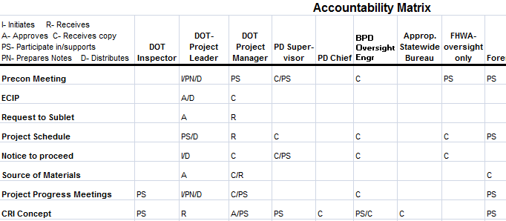
Mega Project Management Expectations
Project leaders and managers are responsible
and accountable for making sure decisions are
made.

Slide 66
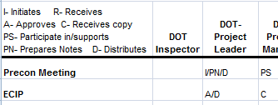
Mega Project Management Expectations
*Timelines need to be agreed upon

Slide 67
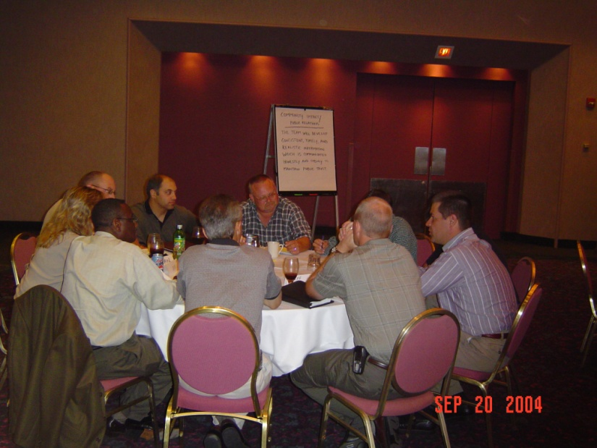
Tools and Best Practices to help meet these expectations
Partnering is a way of conducting business that
promotes open communication, trust,
understanding, and teamwork in day-to-day
operations.

Slide 68
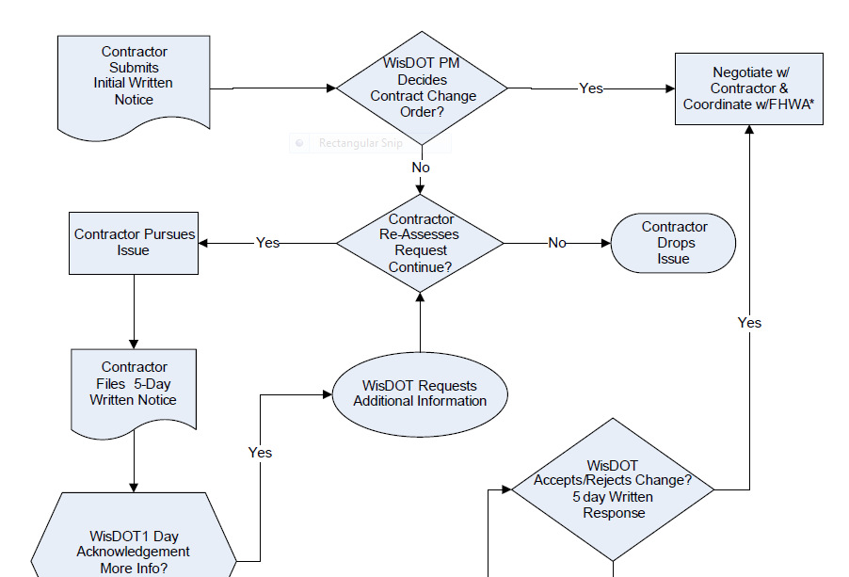
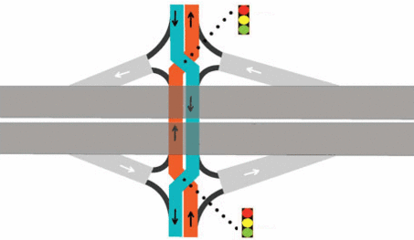
Tools and Best Practices to help meet these expectations
Innovation is encouraged.
New Processes
Innovative designs
New Technology

Slide 69
Tools and Best Practices to help meet these expectations
Innovation is encouraged.
BUT ….

Slide 70
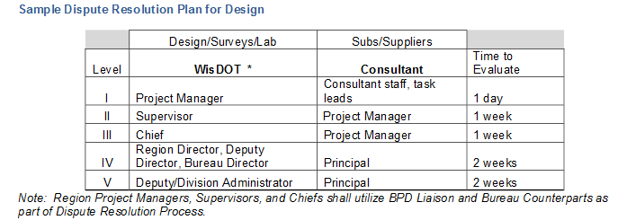
Tools and Best Practices to help meet these expectations
A dispute resolution plan helps prevent
opposing parties from arriving at an impasse.

Slide 71
Staffing and organization of Mega projects (Sections 4 & 6)
Regions have flexibility on how they organize
the delivery team
Guidelines provide a functional org chart
Guidelines provide generic roles &
responsibility descriptions by position
Key is not how the team is organized but
rather how decisions are made and how timely they are made.

Slide 72
Staffing and organization of Mega projects

Slide 73
Generic Roles and Responsibilities for Mega Project Management

Slide 74
Staffing and organization of Mega projects
Mega projects can have different staffing models.
DOT
Consultant
DOT
Consultant
DOT
Consultant

Slide 75
Best practices from WisDOT’s Mega projects (Section 13)
Best practices are processes or methods that
lead to enhanced project performance when
effectively executed.
- Construction Industry Institute

Slide 76
Best practices from WisDOT’s Mega projects
Mega Project Best Practices Guidelines detail
global best practices.
Efficient and effective use of resources
Management, communication and
dissemination of key information
Leveraging knowledge and expertise
Facilitation of continuous organizational
improvement

Slide 77
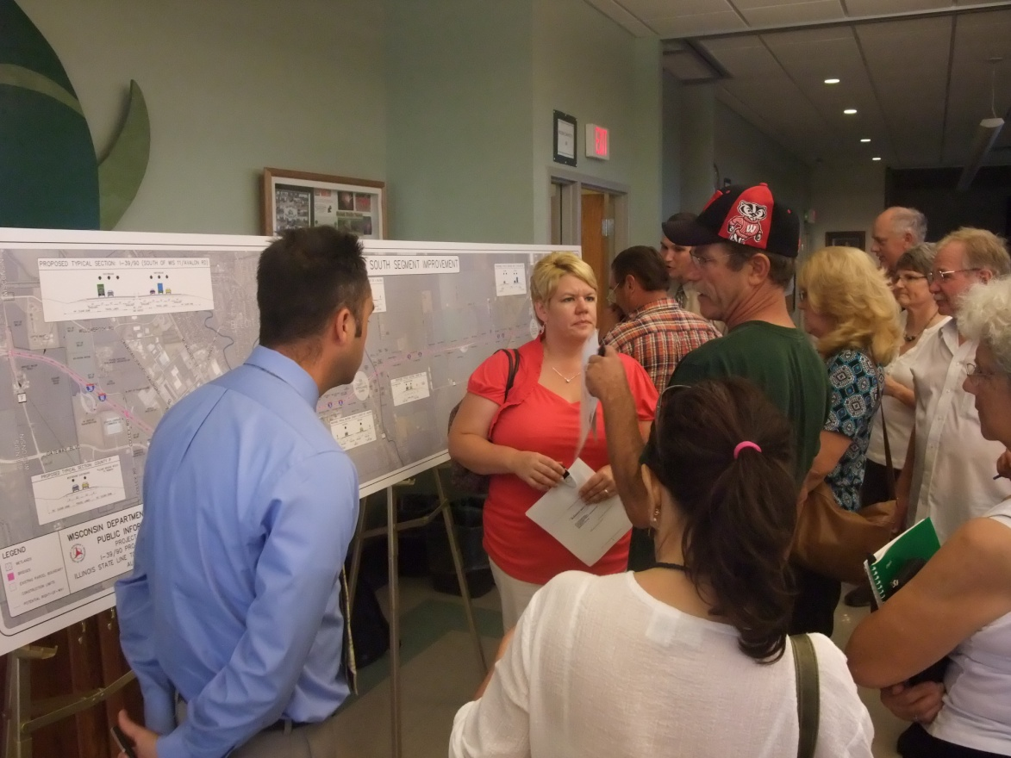
Best practices from WisDOT’s Mega projects
The Mega Project Guidelines provide
Public Involvement best practices.

Slide 78
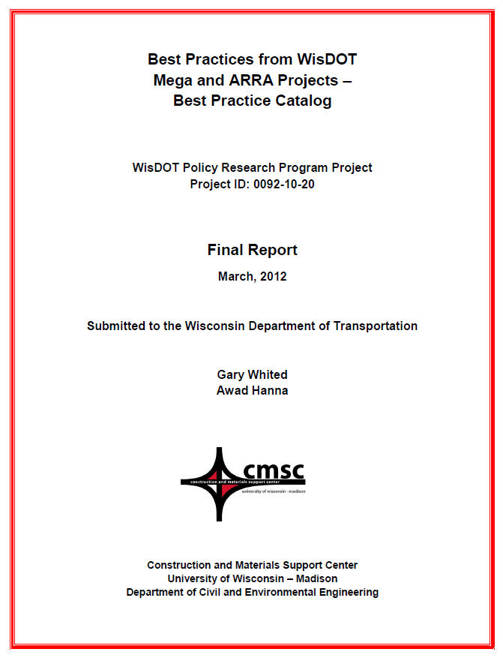
Best practices from WisDOT’s Mega projects
Provided for each BP:
● Title
● Brief description
● details to aid in implementation
● Objective
● When to apply
● Cost implications
● Conditions for successful
application
● Cautions

Slide 79
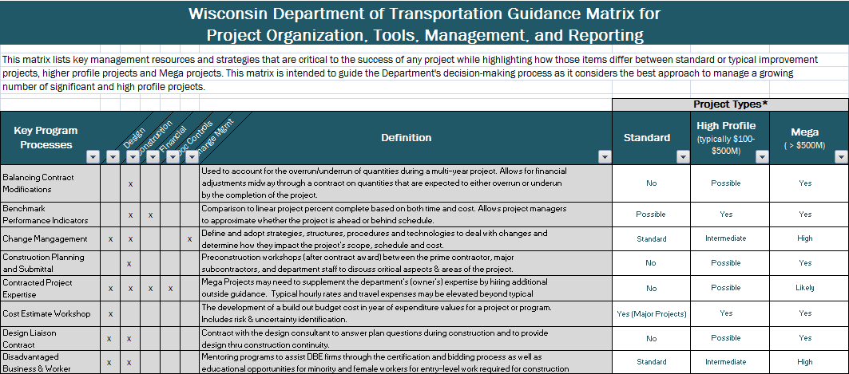
Best practices from WisDOT’s Mega projects

Slide 80
Panel Discussion on Mega Projects
Participants:
Brian Roper – NER
Tracey Blankenship – FHWA
Steve Krebs – SWB
Robert Fieldbinder – URS
Notes:
Participants: include:
WisDOT experienced mega project person
Statewide Bureau Person
Consultant experienced mega project person
FHWA
Answer Questions from the Audience
Take away points:
Fast paced timeline means decisions get made
Challenge to balance need to keep team members informed and the need to meet timelines
You need to do your part so others can do theirs

Slide 81
Break
Please return at:
Notes:
Box lunch to be provided so participants remain on sight and have chance interact with each other.

Slide 82
Training Evaluation
Thank you for your participation.
Please take the time to give us your candid feedback so that we know what to modify to provide the most effective training we can.
Notes:
Participants: include:
WisDOT experienced mega project person
Statewide Bureau Person
Consultant experienced mega project person
FHWA
Answer Questions from the Audience
Take away points:
Fast paced timeline means decisions get made
Challenge to balance need to keep team members informed and the need to meet timelines
You need to do your part so others can do theirs

