Slide 1
Local Small Structure Improvement Program (LSSIP)
2026-2027 Program Cycle Informational Webinar
2/19/2026

Slide 2
Today’s WisDOT Presenters
Merrill Mechler-Hickson – Local Programs & Finance Section Chief
Josh Dietsche – Bureau of Structures (BOS) Director
Izzy Schultze – Statewide Local Small Structure Improvement Program (LSSIP) Manager

Slide 3




Local Small Structures Program
Josh Dietsche
Director – WisDOT Bureau of Structures
February 19, 2026

Slide 4

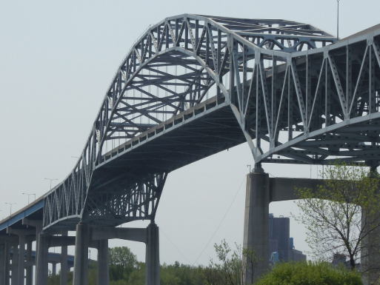
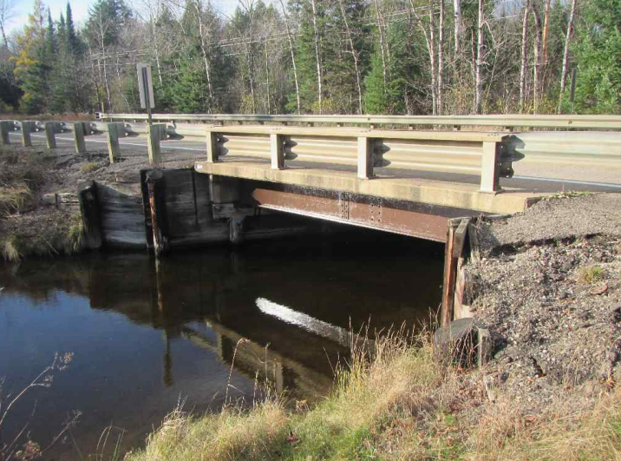
What is a bridge?

Slide 5
What is a bridge?
The definition of a bridge is found in the Code of Federal Regulations (CFR)
  CFR 650.305
  A structure including supports erected over a depression or an obstruction, such as water, highway, or railway, and having a track or passageway for carrying traffic or other moving loads, and having an opening measured along the center of the roadway of more than 20 feet between under copings of abutments or spring lines of arches, or extreme ends of openings for multiple boxes; it includes multiple pipes, where the clear distance between openings is less than half of the smaller contiguous opening.

Slide 6
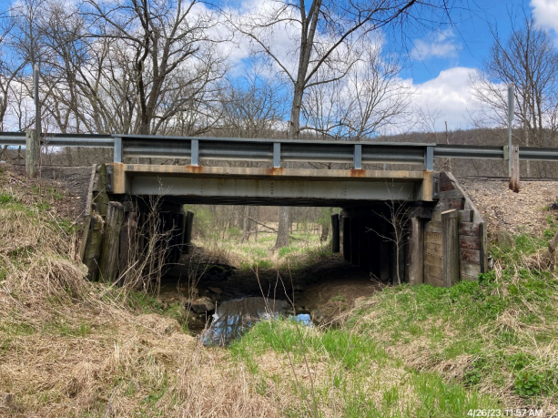
What is a bridge?
Bridges and “not bridges” can look and act very similar
C-21-50
USH8 over Rat River
Span = 19’-11”
B-12-818
STH131 over Branch of Kickapoo River
Span = 24’-0”
NOT A BRIDGE
BRIDGE

Slide 7
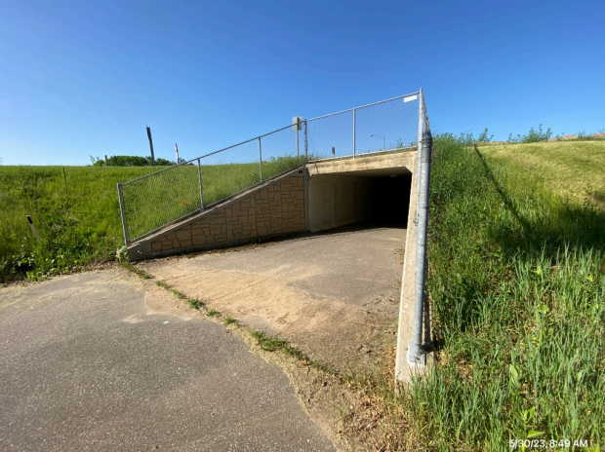
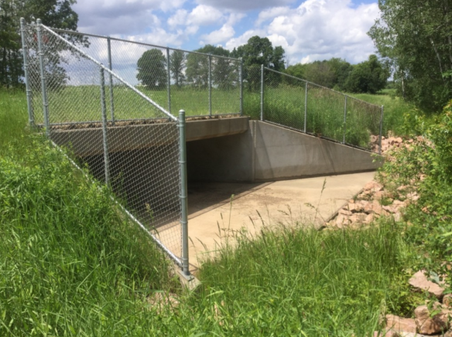
What is a bridge
Bridges and “not bridges” can look and act very similar
C-1-10
STH13 over Pedestrian Trail
Span = 15’-0”
B-3-198
STH25 over Branch of Yellow River
Span = 2 x 12’-0” = 24’-0”
NOT A BRIDGE
BRIDGE

Slide 8
Why Does this matter?
Bridges (structures > 20 ft)
Structures < 20 ft
Required to document inventory information
No inventory requirements
Required to inspect on a regular cycle
No inspection requirements
Required to load rate and post (as necessary)
No load rating or posting requirements
Eligible for the Local Bridge Program (funding)
NOT Eligible for the Local Bridge Program

Slide 9
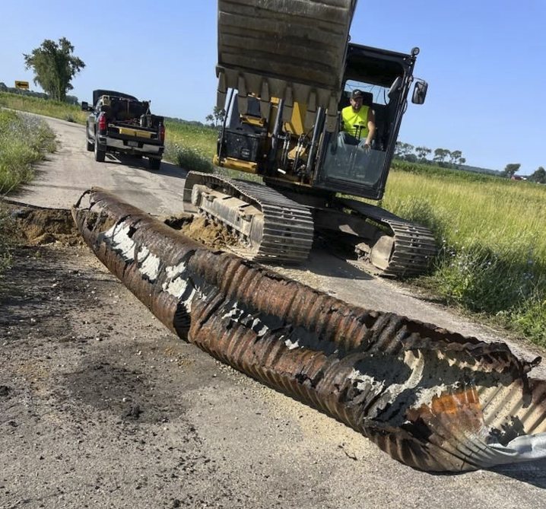
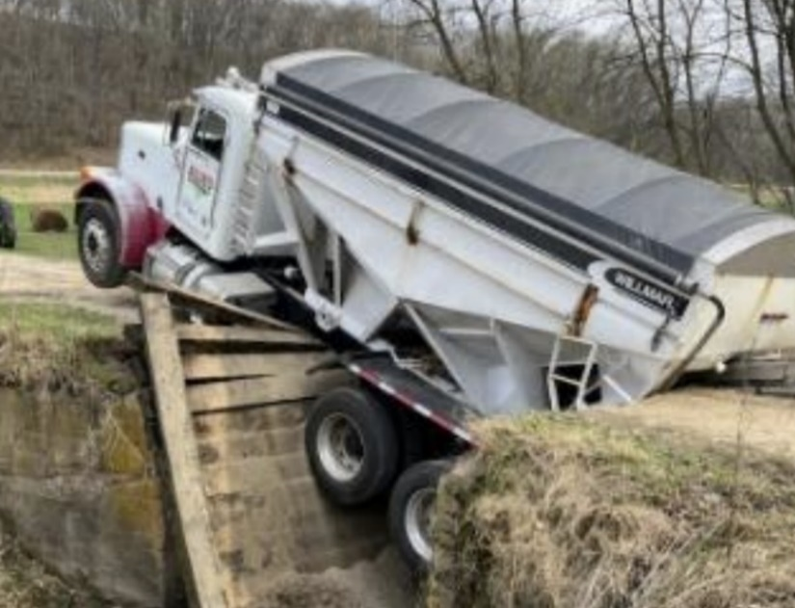
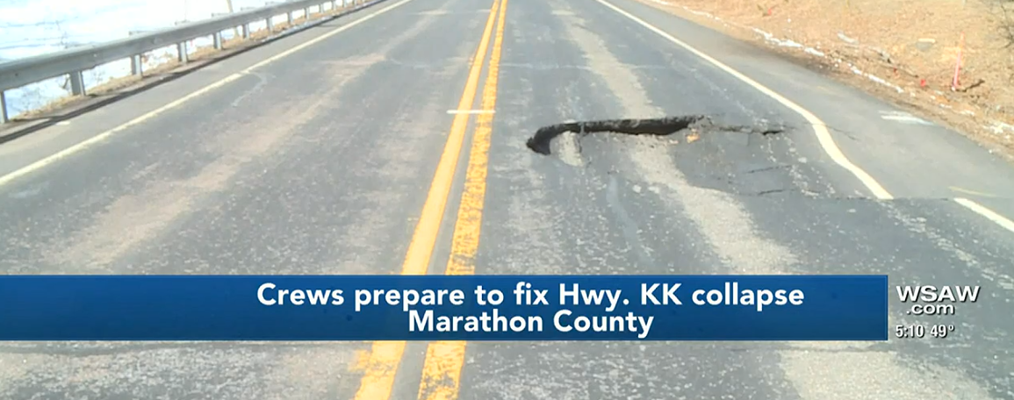
Why Does this matter?
Small structures can still present issues…
…and require funding to repair or replace.

Slide 10
Wisconsin 2023 – 25 State Budget
Budget Language
  Provides $12,500,000 SEG to JCF’s supplemental appropriation in FY24 for assessment of local bridges and culverts and create a biennial DOT SEG appropriation that could receive the funds. Directs the Department to develop a program for counties to assess local bridges and culverts that are less than 20 feet, but greater than six feet in length.
State Statute 85.64
  The department shall administer a program for counties to inventory and assess the condition of local bridges and culverts that are 20 feet or less in length but greater than 6 feet in length.

Slide 11

Wisconsin 2023 – 25 State Budget
Collaborative effort to develop a program
  Wisconsin DOT
  Wisconsin Towns Association
  League of Wisconsin Municipalities
  Wisconsin Counties Association
  Wisconsin County Highway Association

Slide 12
Current Status
16,755 structures in HSIS
For reference:
  About 14,000 total bridges in the state
  About 9,000 local bridges in the state

Slide 13
Current Status
Inspections performed by Wisconsin certified bridge inspectors
Based on National Bridge Inspection (NBI) rating scale (0 – 9)
  0 – 2: Severe condition
  3 – 4: Poor condition
  5 – 6: Fair condition
  7 – 9: Good condition

Slide 14
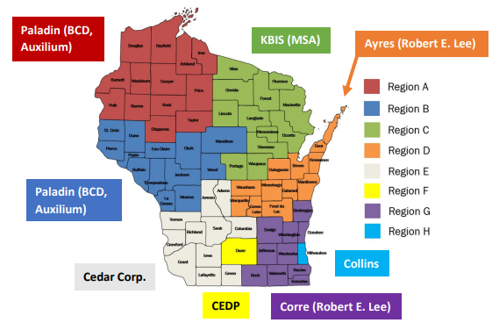
Current Status
Counties were responsible for inspecting county system
  Either with county staff or hiring a consultant of their choice
Consultant contracts for city, town, and village inspections

Slide 15
Current Status - Inspections
Structure Condition
  49.9% good condition
  40.3% fair condition
  9.2% poor condition (~1500 structures)
    Likely need some kind of action in the next 5-10 years (structure dependent)
  0.6% severe condition (~100 structures)
    Need attention now
Severe condition…
~90% Good or Fair

Slide 16
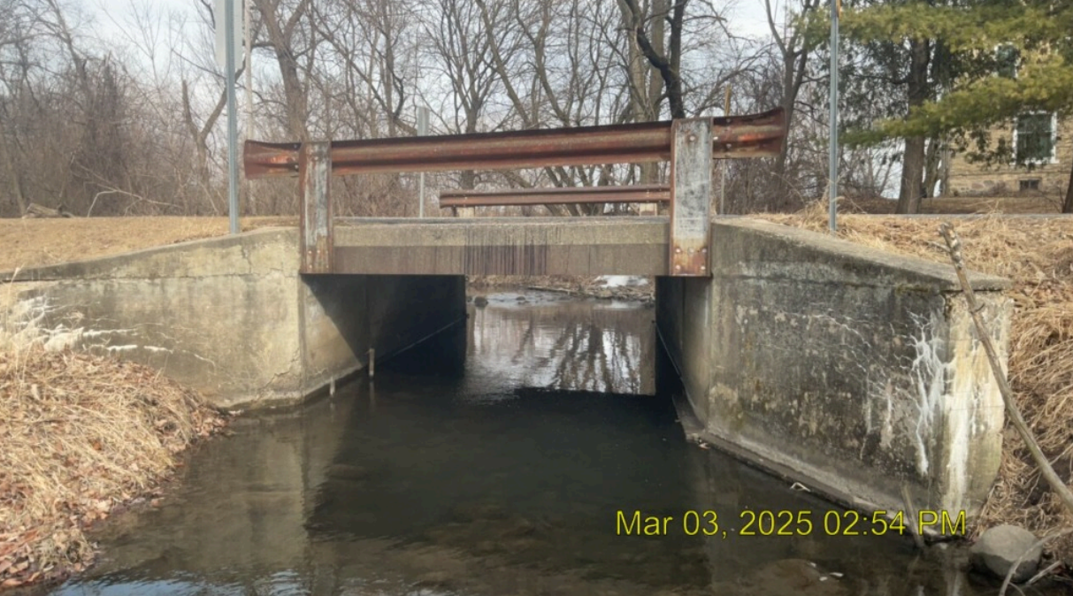

Slide 17
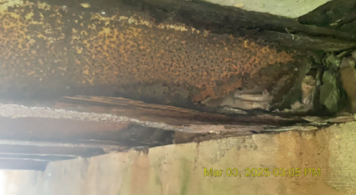
Very possible that local owner assumes this is a bridge and getting inspected…

Slide 18
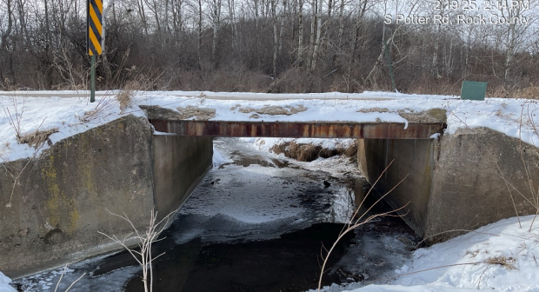

Slide 19
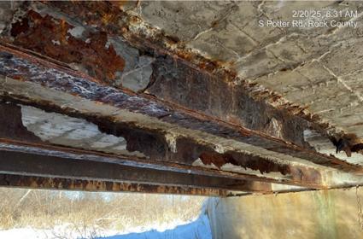

Slide 20
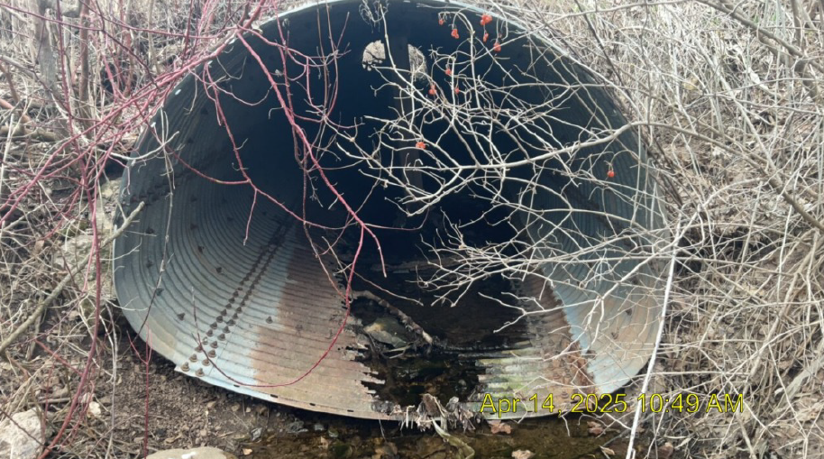

Slide 21
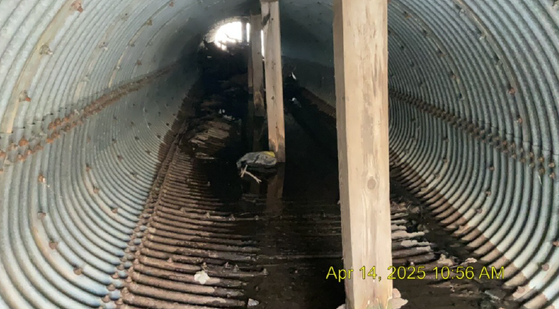

Slide 22
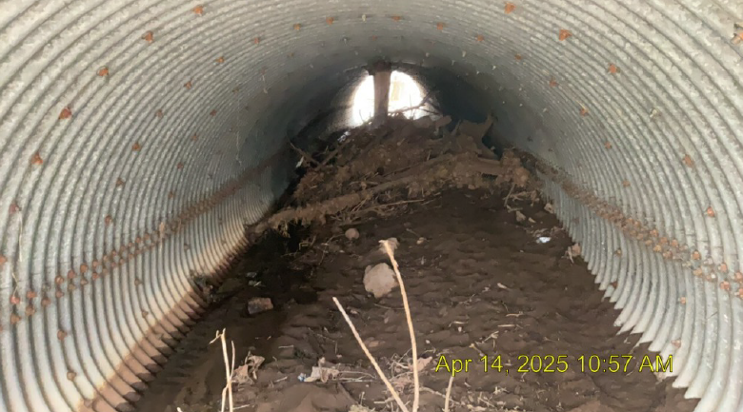

Slide 23
What we need from you
WisDOT is facilitating this effort, but these are local structures
  Safety first – please take immediate action as needed
  We’ve asked inspectors to notify local owners when they see issues that may be an immediate safety risk

Slide 24
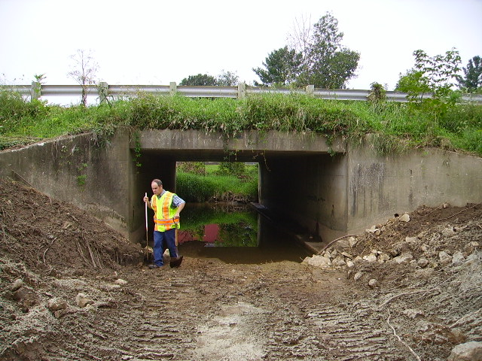
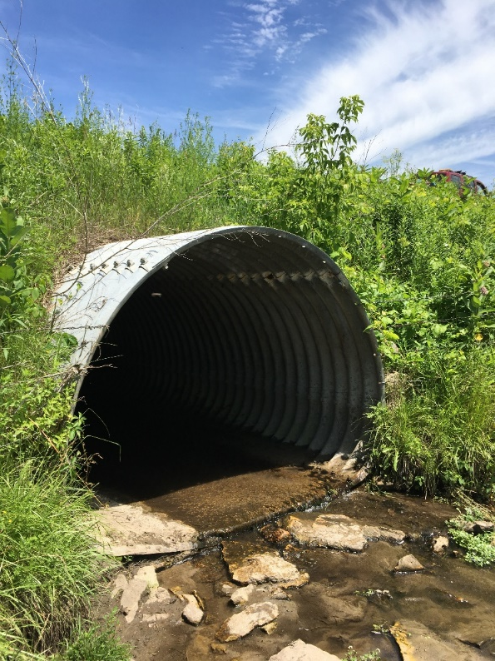
Questions
I’m missing a structure – what happened?
  Inspection determined structure was ineligible – too short.
  Must be greater than 6ft.

Slide 25
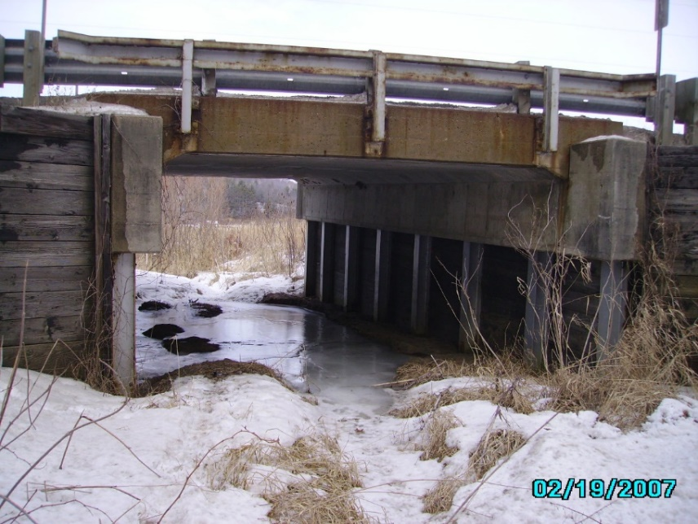
Questions
I’m missing a structure – what happened?
  Inspection determined structure was ineligible – too long.
  Must be 20ft or less.
  “Found” about 150 new bridges.
    Assigned a bridge number, treated as a bridge

Slide 26
Questions
I’m missing a structure – what happened?
  Incorrect information entered
    Incorrect owner
    Incorrect road, location
  Inspection determined structure was ineligible – not on a local road.
    Private road, driveway
    Part of a storm sewer system

Slide 27
Thank you!
HUGE effort
  16,000+ structures
  Find and inspect
  Short timeframe
Wouldn’t have accomplished without willing local partners

Slide 28
Local Small Structure Improvement Program (LSSIP)
2026-2027 Program Cycle
Izzy Schultze
Statewide LSSIP Program Manager

Slide 29
Local Small Structure Improvement Program (LSSIP) – General Overview
LSSIP is a one-time appropriation authorized as a set-aside of up to $30 million from the Agricultural Roads Improvement Program in the 2025-2027 Wisconsin Biennial Budget (Act 15).
This program (identified in WI State Statute 85.64) aims to inspect, repair or replace deteriorated culverts/small structures.
Projects will be funded at up to a 90% state cost share
Notes:
-

Slide 30
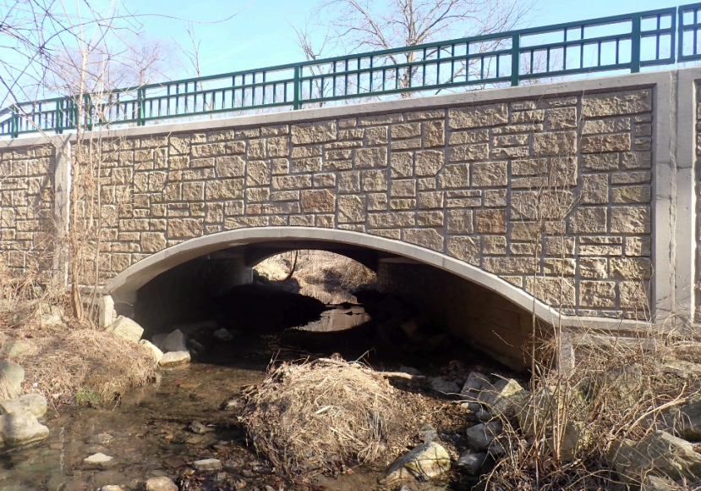
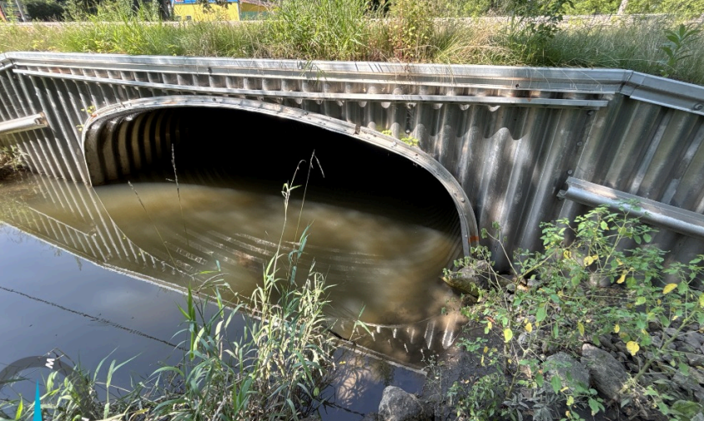
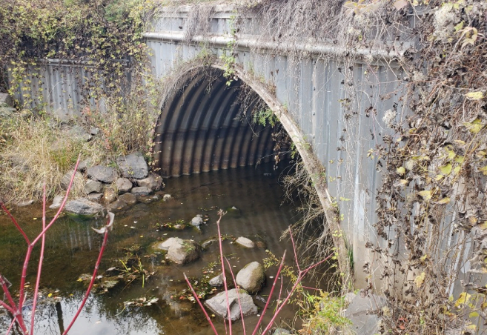
Local Small Structure Improvement Program (LSSIP) – General Overview
Small Structures are structures underneath the roadway that are 20 feet or less in span but greater than 6 feet in span.
Notes:
-

Slide 31





LSSIP Proposed Development Timeline
LSSIP application materials are due 5:00 PM
May 1, 2026
WisDOT anticipates finalizing project selections in June 2026
WisDOT Secretary and Governor anticipated LSSIP Project Award Announcements
Culvert inspection inventory completed in CY2025
LSSIP application materials released February 3, 2026
December 2025
February 3, 2026
May 1, 2026
June 2026
July 2026

Slide 32
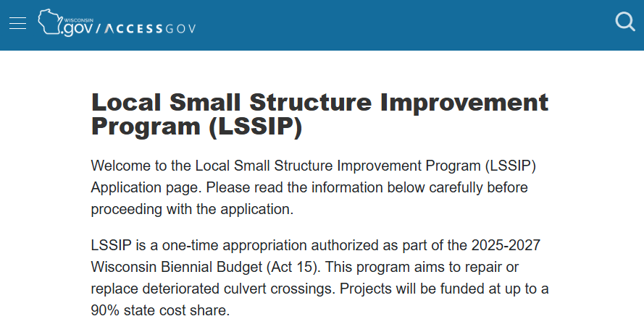
LSSIP Application Intake
Method for application submission: AccessGov
  Same method previously used for the rollout of the 2024-2025 Agricultural Roads Improvement Program (ARIP)
  Application submissions opened on February 3, 2026
    Due date: 5pm, May 1, 2026

Slide 33
LSSIP Application Intake
Applicants are able submit multiple structures in a single application if these structures serve the same drainage function and are less than 20 feet apart. If an application includes structures of different ratings, the rating referenced for scoring will be determined by the lowest rated involved structure.
No municipal application limit for structures with Severe condition rating (0-2)
2 application municipal limit for structures with a Poor condition rating (3-4)

Slide 34
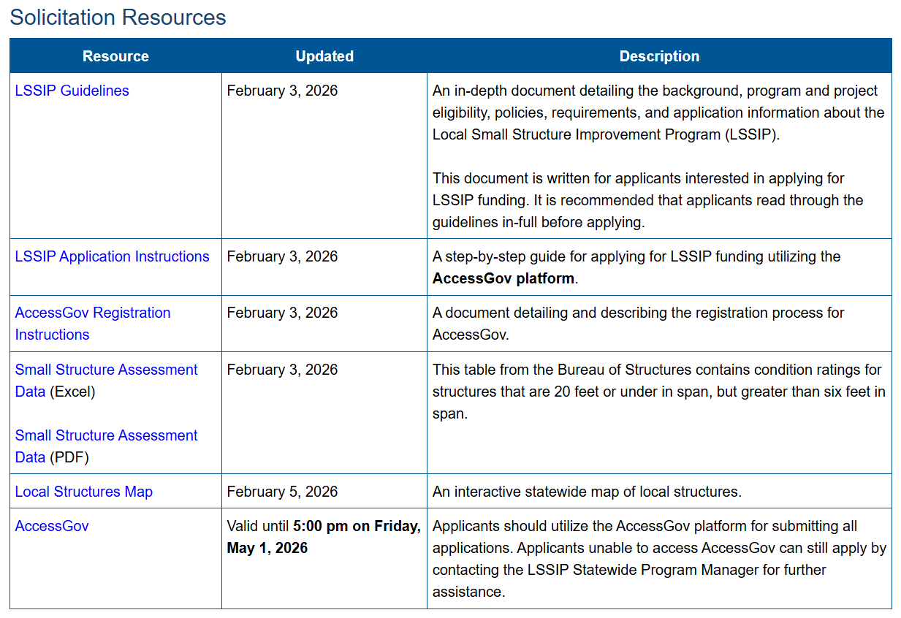
LSSIP Structure Eligibility
Local Sponsors can review structural rating data in 2 places to determine if they have structures that are eligible:

Slide 35
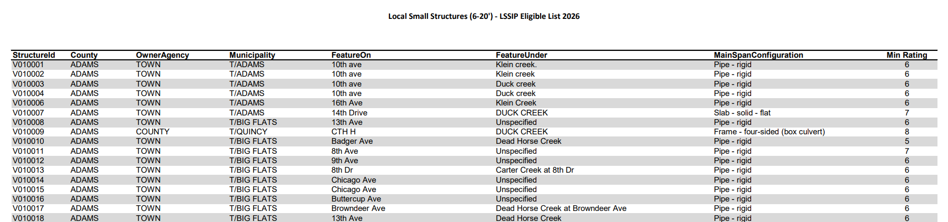
LSSIP Structure Eligibility
Local Sponsors can review structural rating data in 2 places to determine if they have structures that are eligible:
  Small Structure Assessment Data (PDF or Excel)

Slide 36
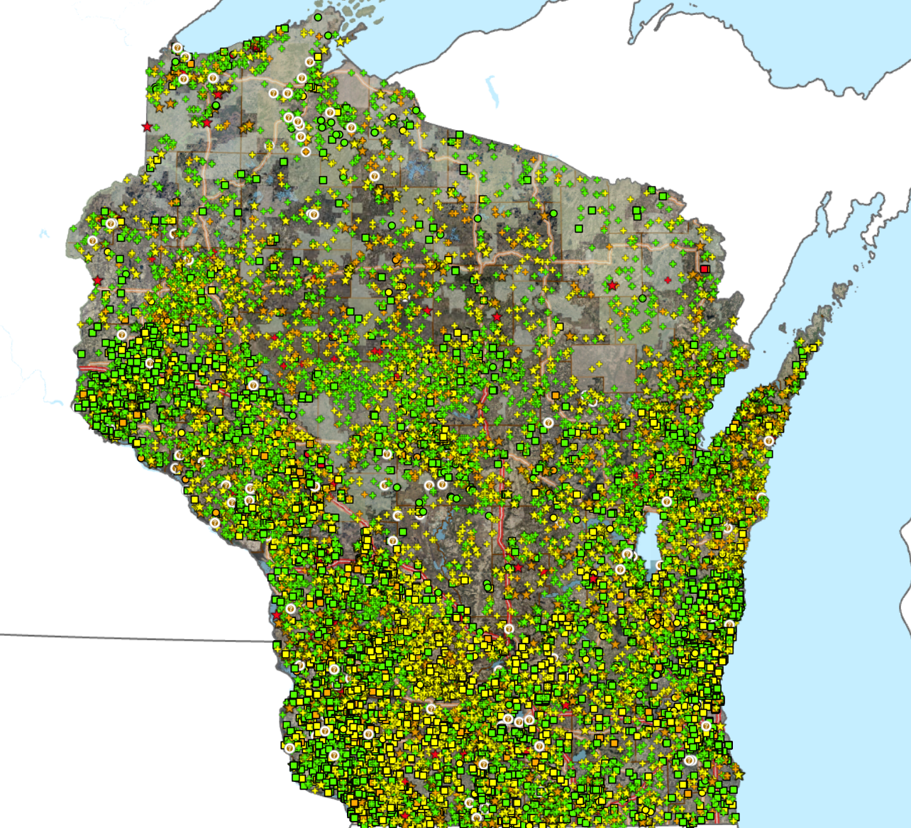
LSSIP Structure Eligibility
Local Sponsors can review structural rating data in 2 places to determine if they have structures that are eligible:
  Local Structures Map
  Green – Good Condition
  Yellow – Fair Condition
  Orange – Poor Condition
  Red – Severe Condition
Legend

Slide 37
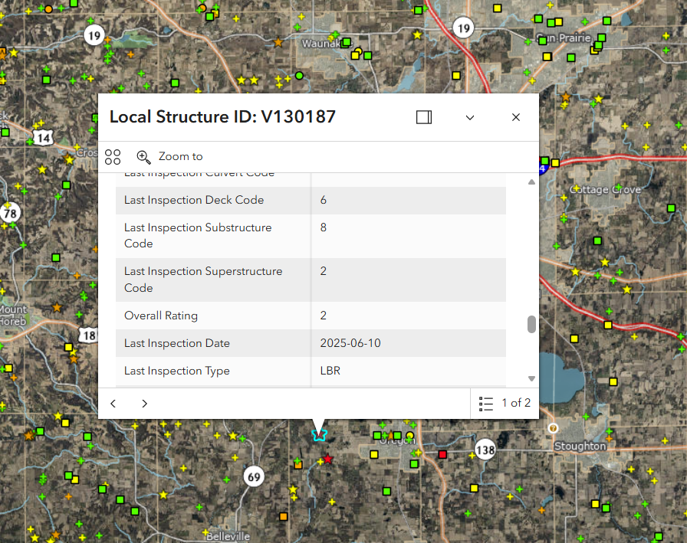
Local Structures Map
To view detail on a structure, click on the icon on the map
Value on this map considered for LSSIP eligibility:
  Overall Rating

Slide 38
LSSIP Project Eligibility
Small structures are structures underneath the roadway that are 20 feet or less in span but greater than 6 feet in span.
  WisDOT also expects that some small structures awarded under the LSSIP program will extend beyond 20 feet after the improvement is completed.
  Newly constructed bridges that extend beyond 20 feet are subject to all state and federal bridge requirements.
  Eligibility is determined by the length of the structure prior to the improvement.

Slide 39
LSSIP Project Eligibility (Cont.)
Small structures that are part of a storm sewer system are not eligible for LSSIP.
The small structure(s) involved in the project must have a condition rating of 4 (poor) or lower as determined by a certified bridge inspector.
Sponsors must submit an application to be considered for an award.

Slide 40
LSSIP Project Eligibility (Cont.)
The project sponsor must be the owner of the small structure(s) involved in the project.
The project sponsor must be a local unit of government.
The amount of paving included in this project should be limited to the minimum safe approach distance to the structure as defined by a certified engineering assessment. Any additional distance will be 100% the responsibility of the local sponsor.
Sponsors should ensure their cost estimate only reflects eligible approach work.

Slide 41
LSSIP Project Eligibility (Cont.)
8. The construction project to improve the structure should have a minimum projected design life of 10 years.
Note: All applicable statutory requirements and WisDOT policy will apply to the LSSIP program.

Slide 42
LSSIP Project Ranking
WisDOT will use the following methodology for the rating and ranking of received applications:
Numeric structure condition rating on the Bureau of Structures (BOS) inspection report.
  All eligible structures that received the most severe rating would be awarded before selection proceeds to the next condition rating.
When reaching a numeric rating where number of structures outstrips remaining available funding, priority would be given to structures located in counties that had not received awards to ensure the most equitable geographic distribution of awards.

Slide 43
LSSIP Project Ranking (Cont.)
Once all counties with valid applications receive an award, priority would be given to structures on a sole access roadway.
The next level of priority will be structures that are causing weight restrictions or closures.
The next level of priority would be given to structures serving a higher functional class of roadway.
In the event an additional tie breaker is required, priority would be given to structures located in municipality types that received a low proportion of awards to ensure a more equitable distribution of awards between Counties, Towns, and Cities/Villages.

Slide 44
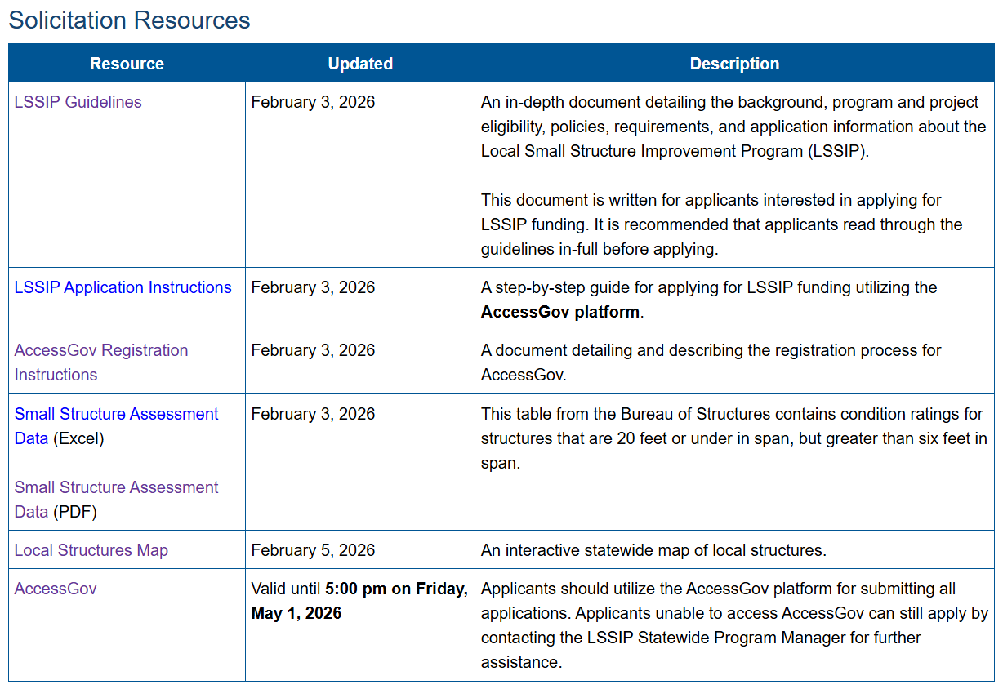
Application Walkthrough
To access the application,
Open the WisDOT LSSIP webpage
Scroll down to the Solicitation Resources table
Click on the AccessGov resource

Slide 45
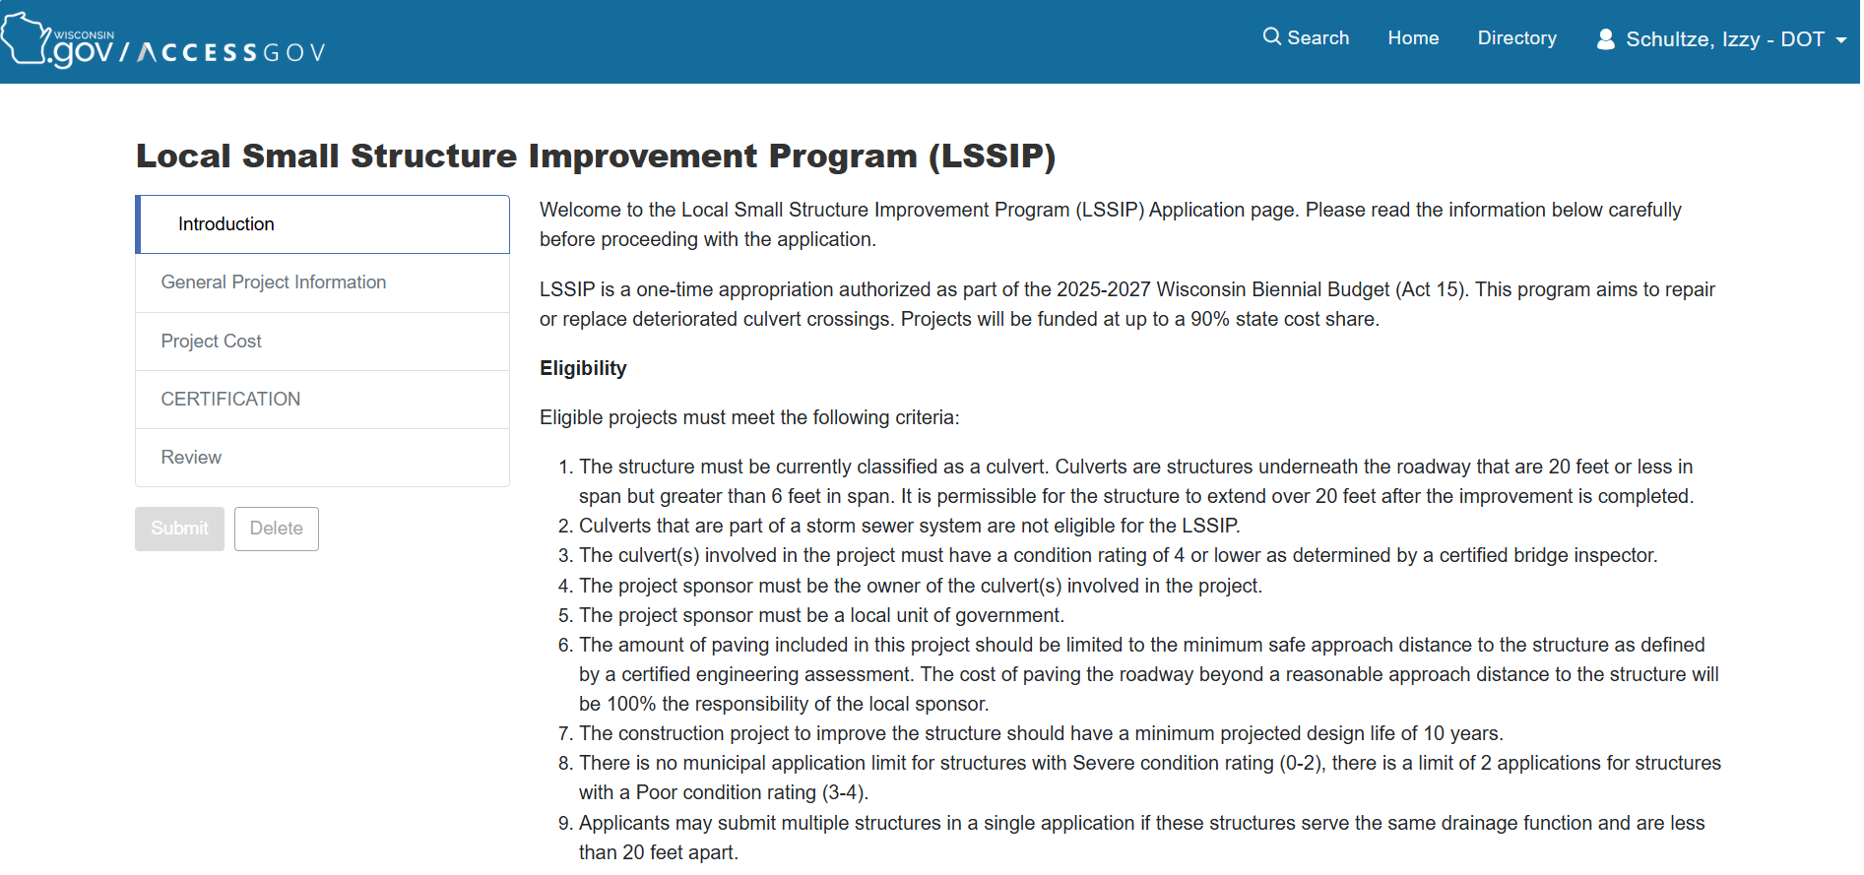
Application Walkthrough
  Review the Introduction page – eligibility requirements, deadline, and application tips

Slide 46
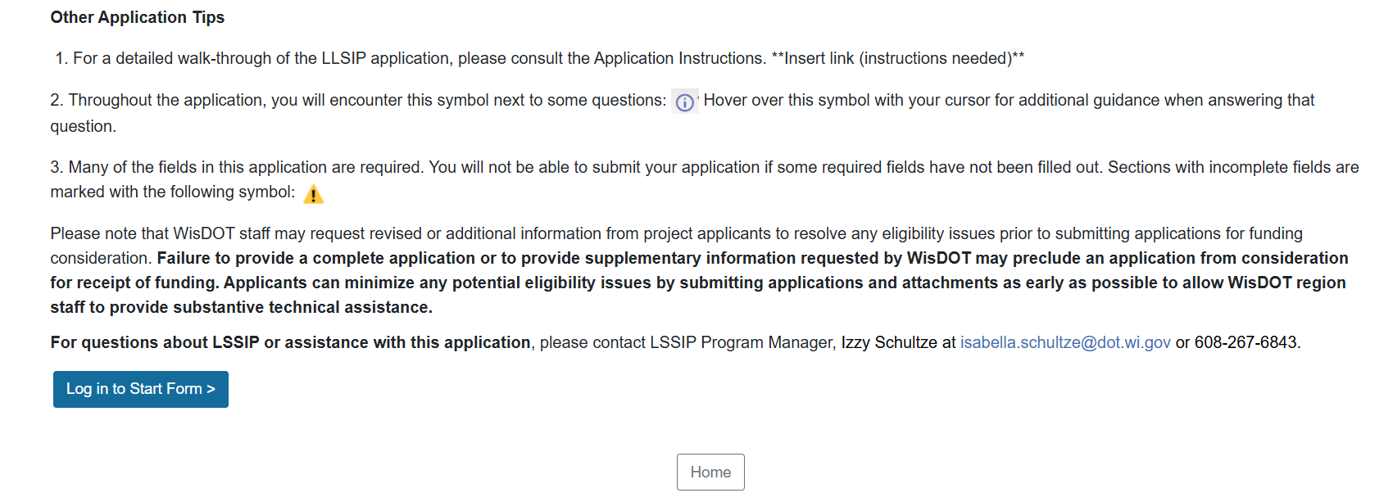
Application Walkthrough
  Review the Introduction page – eligibility requirements, deadline, and application tips

Slide 47
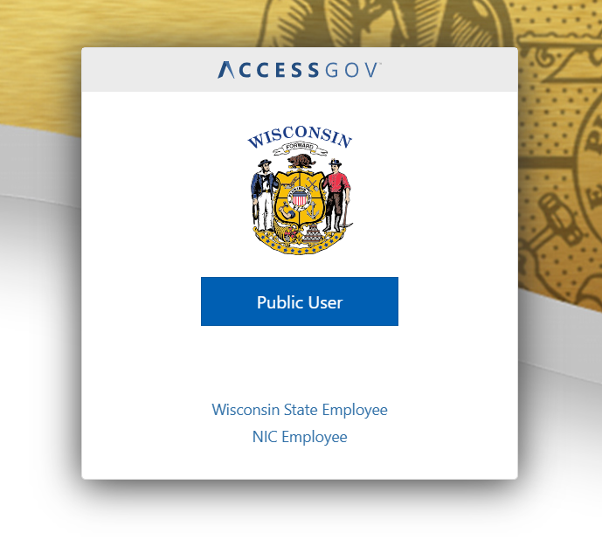
Application Walkthrough

Slide 48
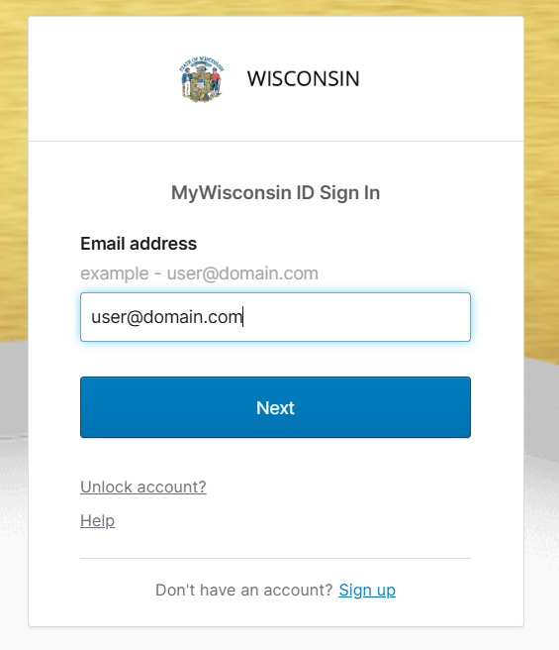
Application Walkthrough
If you have a MyWisconsin ID:
  Fill in your email address
  Press “Next”
If you do not have a MyWisconsin ID:
  Select the “Sign up” link at the bottom of the pop-up
  Follow instructions to create a MyWisconsin ID
  After creating an ID, come back to this page and complete the steps above
v

Slide 49
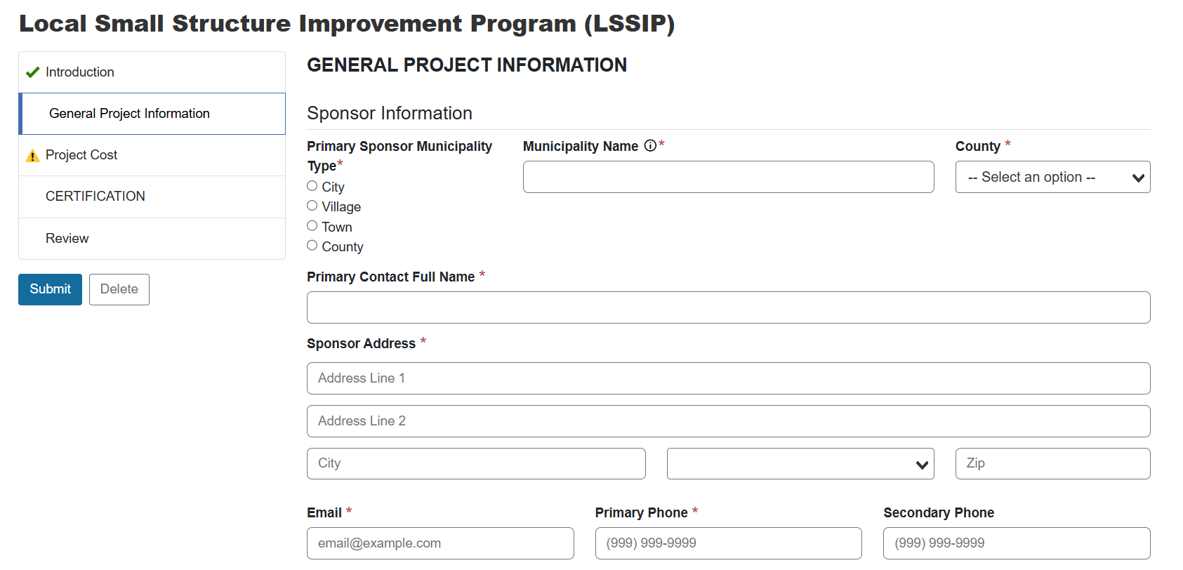
Application Walkthrough
Fill in sponsor details
  The sponsor information must reflect the owner of the structure, but the application can be filled out by a consultant if necessary

Slide 50
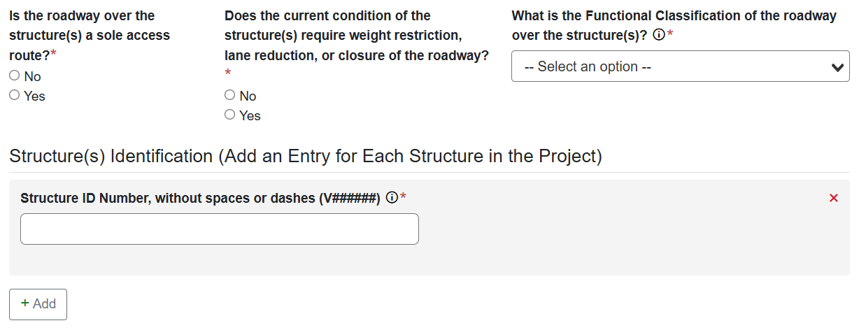
Application Walkthrough
Fill in structure and roadway details
  This information will be verified prior to award
  PLEASE NOTE: All roadway functional classifications are eligible to apply for funding through LSSIP

Slide 51
Application Walkthrough
  Multiple structures can be added to a single application only if:
    The structures serve the same drainage function
    The structures are less than 20 feet apart

Slide 52
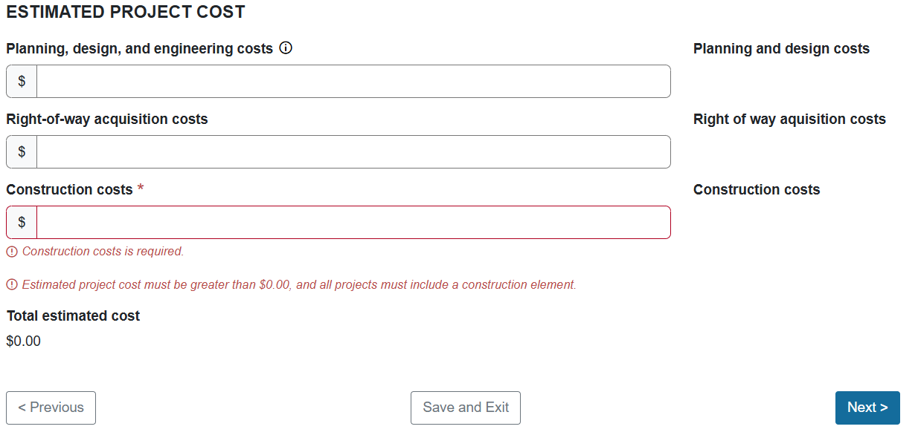
Application Walkthrough
Fill in estimated project cost, then select Next

Slide 53
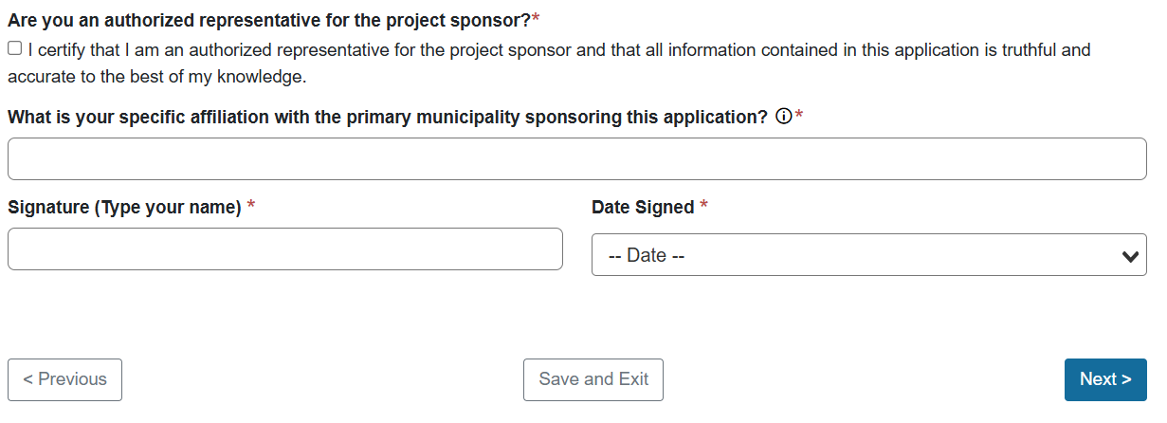
Application Walkthrough
Fill in certification, then select Next

Slide 54
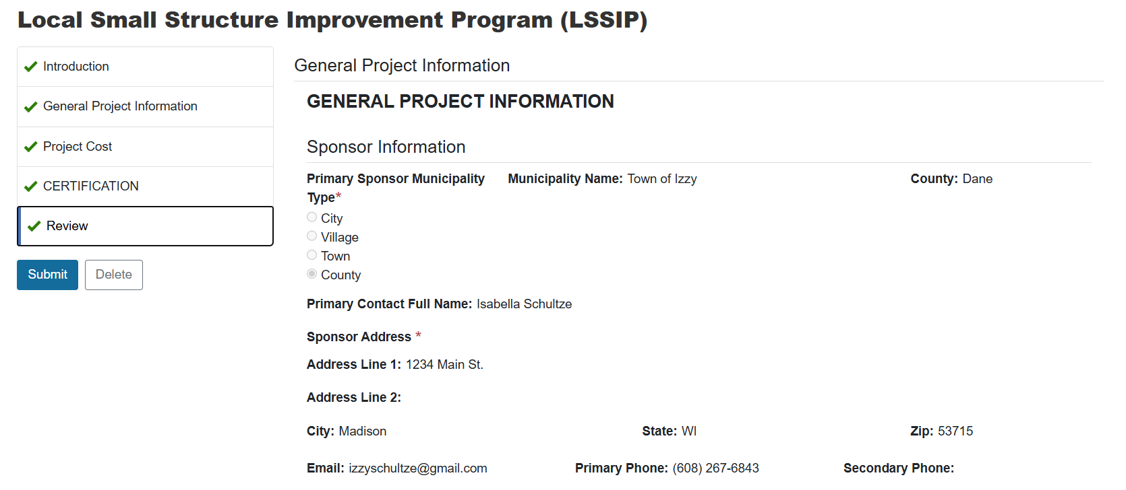
Application Walkthrough
Review information on application, then select Submit

Slide 55
Post-Application Period
LSSIP Application Deadline: 5:00 pm on May 1, 2026
Application review and selection:
  May-June 2026
Anticipated LSSIP award announcements:
  July 2026
The department will reach out to sponsors selected for award for additional information about the proposed work on the structure and the cost estimate prior to issuing a State Municipal Agreement (SMA)

Slide 56
Questions?

Slide 57


WisDOT Estimate Contacts
Isabella Schultze
LSSIP Manager
(608) 267-6843
isabella.schultze@dot.wi.gov
Merrill Mechler-Hickson​
Program and Policy Chief
(608) 261-8977
merrill.mechlerhickson@dot.wi.gov
David Bohnsack
Structures Maintenance Chief
(608) 785-9781
david.bohnsack@dot.wi.gov
Andrea Bill
Wisconsin LTAP Director
(608) 890-3425
bill@wisc.edu

Slide 58

Thank you!

