Slide 1
WIS 35
(2nd Street / 6th Street)
Front St. to North End Road
Public Involvement Meeting #3
February 26, 2020
Notes:
Welcome.

Slide 2
Introductions
Mohamad Hayek, PE – WisDOT
Jeff Abramson, PE – Ayres Associates
Nate Woolever, PE – Ayres Associates
Brad Becker, PE – CBS²
Nanette Vetsch - WisDOT Real Estate
Heather Dresel – WisDOT Real Estate
Notes:
Intros

Slide 3
Agenda
STH 35 Project Overview
Need for project
Proposed project
Maintenance of Traffic
Schedule
Questions

Slide 4
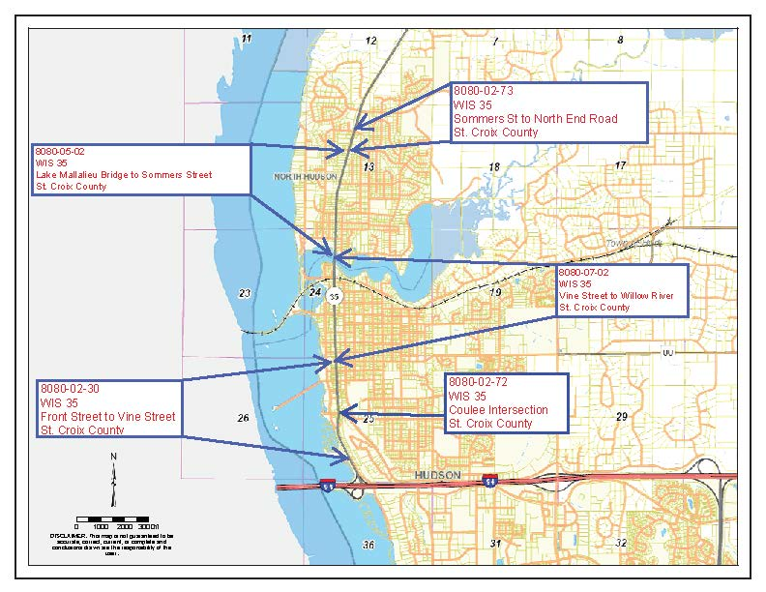
Project Location
Notes:
Discuss 3 project segments. South Rehabilitation, and north two are reconstruct.

Slide 5
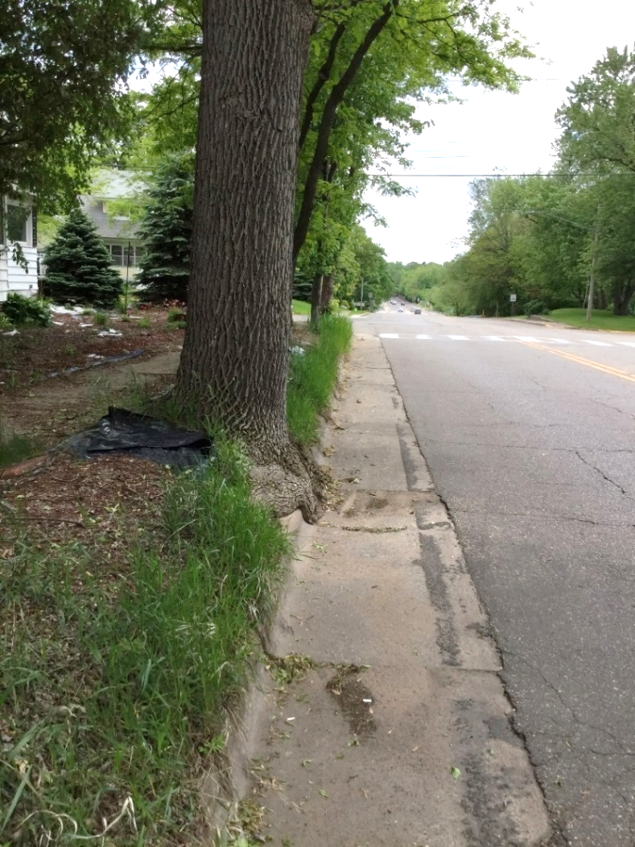
Need for project
Poor pavement condition
Deteriorated utilities
Storm, Water, Sanitary
Safety
Substandard curb ramps
Buckeye Street/Coulee Road Intersection
Substandard Vertical Clearance at RR
Sommers – North End Road turning movements
Notes:
Overall need is due to pavement condition. Roadway and facilities have exceed their useful life.
Address substandard curb ramps, Coulee intersection, vertical clearance at RR.

Slide 6
Proposed project
Typical Sections
South project the typical section will remain the same except:
Near Buckeye/Coulee the typical cross section is changing slightly to improve safety.
Typical Section will typically remain the same on the middle two projects except near RR overpass.
Narrowed to accommodate profile at RR.
North project typical section will be changed from a two-lane to a three-lane.
Notes:
Explain typical section (same number of lanes and widths)

Slide 7
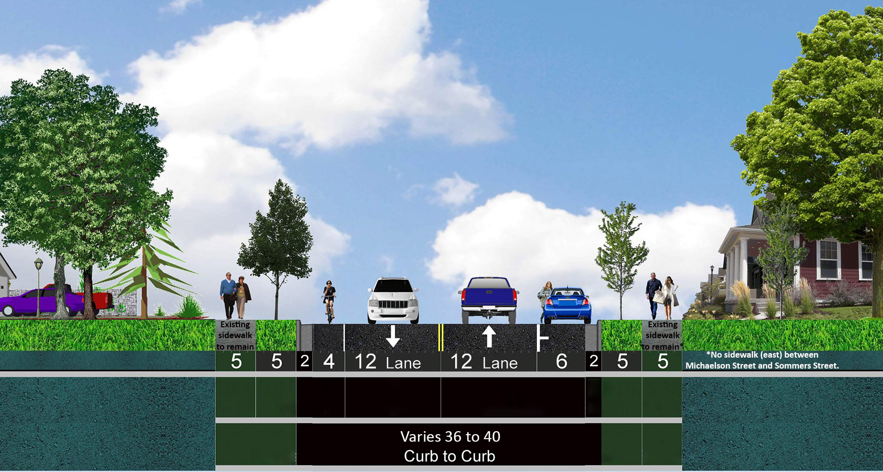
Proposed project
Notes:
Typical for 36’ and 40’ section.

Slide 8
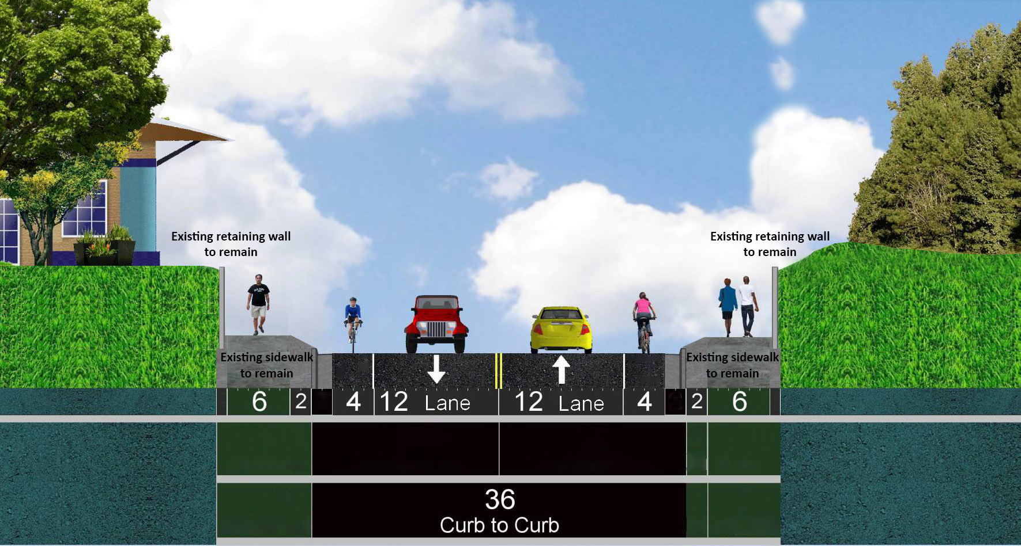
Proposed project
Notes:
Typical section near walls / RR overpass. Much of this is currently 40’. Changing to 36’. Eliminates parking. Need to do in order to leave sidewalks and walls in place.

Slide 9
Proposed project
Rehabilitation on south project (Front St. to Vine Street):
Joint repair, coarse grind, asphaltic overlay
Safety improvement at Buckeye St. / Coulee Rd
Curb ramp improvements
Spot sanitary sewer repair and improvements
Replacement lighting
Notes:
Describe project

Slide 10
Proposed Project
Notes:
Realigns slightly to get opposing left turns. Removes small raised medians that are currently there.

Slide 11
Proposed Project
Notes:
Realigns slightly to get opposing left turns. Removes small raised medians that are currently there.

Slide 12
Proposed project
Reconstruct on two projects between Vine St. and Sommers St.:
New utilities (storm sewer, water, sanitary sewer), new curb and gutter, curb ramps, profile modification, traffic signal (Coulee and Monroe), pavement structure
Change typical section of roadway from River St. to bridge (removal of parking)
Tree Removal in boulevard
Polymer overlay on Lake Mallalieu Bridge
Notes:
Sidewalks to remain

Slide 13
Proposed project
Rehabilitation on northerly project (Sommers St. to North End Road):
Roadway widened to the east
Change typical section of roadway from a two-lane rural section to a three-lane section with a Two-Way-Left-Turn-Lane (TWLTL) with rural shoulder on the west and curb and gutter on the east.
Mill and overlay existing roadway
Notes:
Describe project

Slide 14
Proposed project
Bike and Pedestrian Accommodations:
Existing Sidewalk throughout the project for pedestrian accommodations.
Bike trail /Sidewalk from southerly project limits to Buckeye.
On-Street bicycle from Buckeye to First Street paralleling STH 35.
On-Street from River Street to STH 35.
On-Street on STH 35 from River Street to the north.
Notes:
Describe project

Slide 15
Maintenance of Traffic
Single Lane bi-directional traffic on southerly project from Front to Vine.
No-parking from Coulee to Vine.
Notes:
Half at a time on south project. Parking lane will become one of the thru lanes.

Slide 16
Maintenance of Traffic
Notes:
Design image of bi-directional under construction.

Slide 17
Maintenance of Traffic
Roadway closed for northerly two projects.
Detour provided.
Previous Detour (CTH UU, CTH A, CTH E)
New / Proposed Detour (TH 95, TH36/STH 64, STH 35)
Access to residents and businesses maintained
Notes:
Roadway closed and detoured to thru traffic. Investigating detour route. Likely detoured at Coulee Road.
Need to provide access to property owners, businesses, and emergency vehicles.

Slide 19
Maintenance of Traffic
Roadway closed for northerly two projects.
Structure across Lake Mallalieu open to a minimum of one lane of traffic via temporary traffic signals

Slide 20
Maintenance of Traffic

Slide 21
Maintenance of Traffic

Slide 22
Maintenance of Traffic

Slide 23
Maintenance of Traffic
Staged to limit closures along entire corridor

Slide 24
Maintenance of Traffic
Real Estate Acquisition
R/W Plat for North Hudson is filed.
R/W Plat for Hudson is close to being filed.
Anticipate r/w acquisition to start in the next month.
123 Temporary Limited Easements
7 Fee Acquisition
130 Total Parcels (68 City of Hudson and 62 Village of N. Hudson)
Upcoming Real Estate “Blitz” meetings
North Hudson – Thursday, March 26th, Noon – 7:00 pm
Village Hall in North Hudson
City of Hudson
TBD

Slide 25
Schedule
PIM #1 September 2018
Environmental Document Summer 2019
PIM #2 April 2019
Final RW Plat December 2019
Real Estate Acquisition Spring 2020
PIM #3 February 2020
Final Plans May 2020
Construction Spring - Fall 2021
Notes:
Schedule.

Slide 26
THANK YOU FOR ATTENDING
YOUR ATTENDANCE, COMMENTS, AND INPUT ARE GREATLY APPRECIATED!

