Slide 1
DIARY NOTES
The importance of...
Original by Kathy Curren
April 2012 / Updates made December 2015 by Sherry Miner
At the end of this presentation, come back and see additional/supplemental detailed notes

Slide 2
WHAT HAPPENED?

Slide 3
DIARY NOTES & LITIGATION
DIARY NOTES HELP TO TELL THE STORY AND WILL SERVE AS A KEY POINT OF REFERENCE DURING LITIGATION

Slide 4
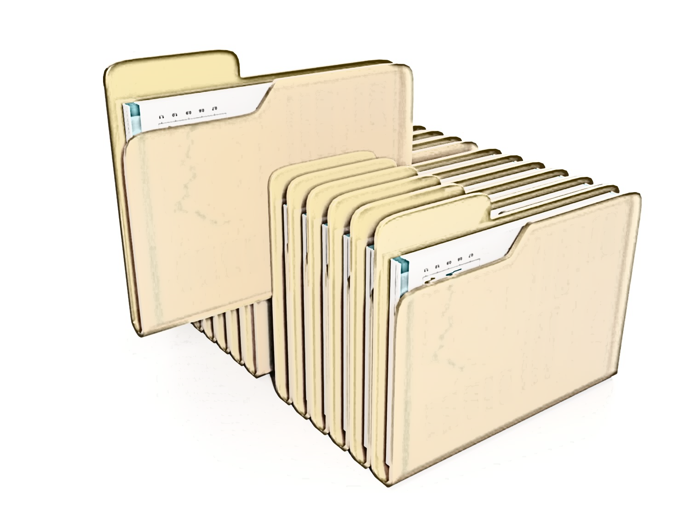
LITIGATION
The regional litigation coordinator serves as the main contact for the attorney assigned to a case. They are responsible for providing the necessary WisDOT support to the assigned attorney. Once a Notice of Appeal is filed, the Real Estate litigation coordinator is responsible for gathering files and all relevant documents, to include first and foremost, diary notes.
Important
Diary Notes

Slide 5
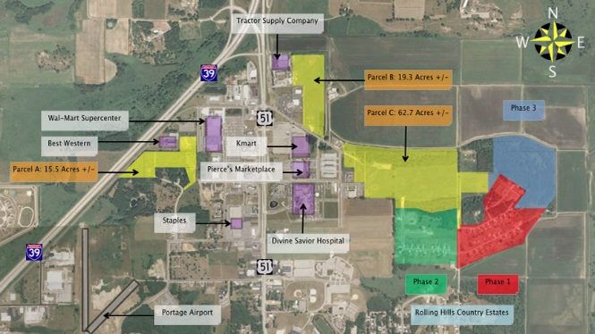
A Diary for Each Parcel
All dates and details of events for every parcel must be documented in the diary and elsewhere throughout READS as appropriate.
A diary must be completed for each separate parcel on a project.

Slide 6
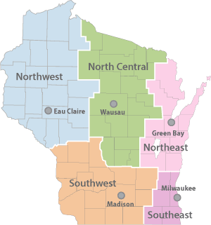
Per REPM/3.1.4 Preparing for Negotiation
Regional parcel acquisition files - The region is responsible for maintaining the official parcel files on all regional projects, including projects handled by consultants. Each parcel file should, at a
minimum, contain:
A parcel checklist or report from READS indicating key dates and parcel status.
Agreement for Purchase and Sale of Real Estate (RE1895 short form or RE1618 long form), if
applicable.
All appraisal reports.
Conveyance form(s) (e.g., deed, TLE, nominal waiver, etc.)
Copies of any written relocation notices given to a displaced person, if applicable.
Copy of initiations of negotiations letter.
Evidence that owner was paid for purchase price and expenses incidental to transfer of property
(e.g., copy of payment request, check, certified mail receipts).
IRS Form W-9.
Negotiation Diary (RE2058).
Property inventory forms when there is a purchase/sale of buildings.
Property's legal description.
Real Estate Transactions Closing Statement (RE1617), if applicable.
Statement to the Construction Engineer (RE1528).
The Rights of Landowners Under Wisconsin Eminent Domain Law brochure.
Mailed or given to owner(s) before first monetary offer to acquire is made. Delivery must be documented in parcel acquisition file.
Title search information.

Slide 7
DIARY NOTES TELL...
Was this a friendly or hostile negotiation?
Any refusals to cooperate or difficulties must be especially detailed and documented!
Were phone calls returned? Messages left? Documents signed?

Slide 8
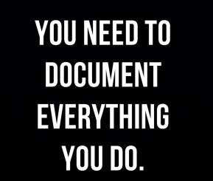
Don’t forget!
Don’t delay!
PUT IT IN THE DIARY

Slide 9
PUT IT IN THE DIARY
Were there meetings? When and where?
Who was there? Who decided what?
Care should be taken to thoroughly document an owner’s direction to negotiate with a representative, if this was the case.

Slide 10
PUT IT IN THE DIARY
Out of state owner’s will require additional and careful coordination in order to present all of the facts and get questions answered. Use the diary to document activities.
Date of delivery for owner’s rights brochures and letters must be noted.
Use diary to document reason for any revisions.
Any agreements, disagreements, changes, issues, and even seemingly small developments must be documented in diary.

Slide 11
PUT IT IN THE DIARY
What do property owners expect? Put it in the diary!
What are owners basing their do$$ar amounts on?
What would it take to close?
If negotiations result in a new offering price, this requires the region to replace the original offering price in READS with the new amounts and to update all other related and appropriate fields in READS. A notation must also be included on the Negotiation Diary (RE2058) to give reason and documentation for the change in offering price. The diary should indicate the original offering price and acreage and then indicate the new offering price and acreage, if changed.

Slide 12
PUT IT IN THE DIARY
Did the department run out of time to negotiate and then had to condemn? Put it in the diary!

Slide 13
PUT IT IN THE DIARY
All discussions and meetings with property owners; note whatever issues the property owner has or concerns.
All discussions and meetings with any parties of interest.
All discussions and meetings with management and other staff including what was decided/not decided.
Diary Notes
Diary Notes
Diary Notes

Slide 14
DIARY NOTES
DIARY NOTES SHOULD PRESENT A CLEAR PICTURE (STORY) OF WHAT TOOK PLACE THROUGHOUT THE ACQUISITION PROCESS AND RELATED ACTIVITIES

Slide 15
DIARY NOTES & READS
ALL STAFF AND CONSULTANTS ARE REQUIRED TO GENERATE DIARIES USING WISDOT’s REAL ESTATE AUTOMATED DATA SYSTEM (READS)
Diary
Notes
READS

Slide 16
DIARY NOTES & READS
Using due diligence in completing READS entries and the diary notes, we are able to record, track, document, and present an organized and professional, as well as accurate account of each transaction; and, if necessary, this will enable us to defend our actions with confidence as to who, what, when and where, with the diary notes serving to bring it all together in helping to explain why.

Slide 17
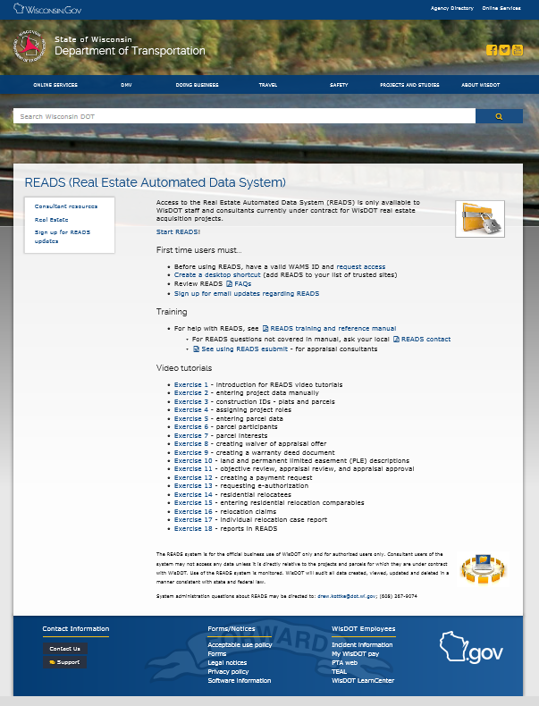
http://wisconsindot.gov/Pages/doing-bus/eng-consultants/cnslt-rsrces/re/reads.aspx
← Start READS
READS

Slide 18
DIARY NOTES
TIMELY, ACCURATE and DETAILED
ENTRIES ARE CRITICAL

Slide 19
DIARY N☺TES
Need to be entered into READS in an on-going, timely, accurate, and detailed manner.
The department needs to show it handles acquisitions in good faith during negotiations. We need to show reasonable efforts in assistance to displaced property owners, and we need to manage any remaining property. Good diary and log entries show that we’ve done all that we are supposed to do.

Slide 20
DIARY N☹TES
You say you don’t have time to do diary notes?

Slide 21
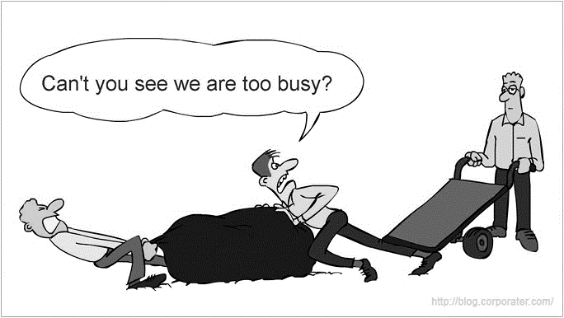
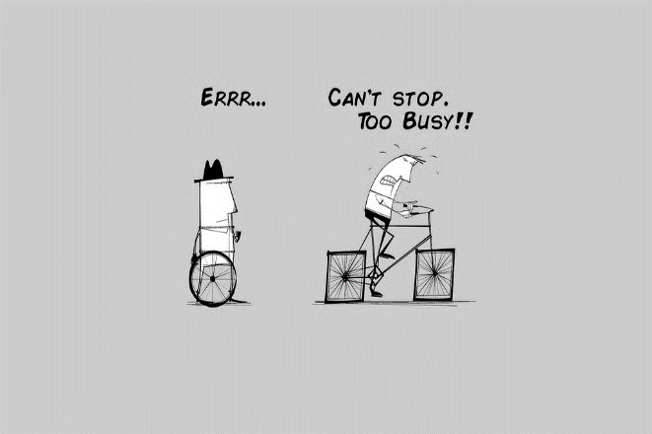
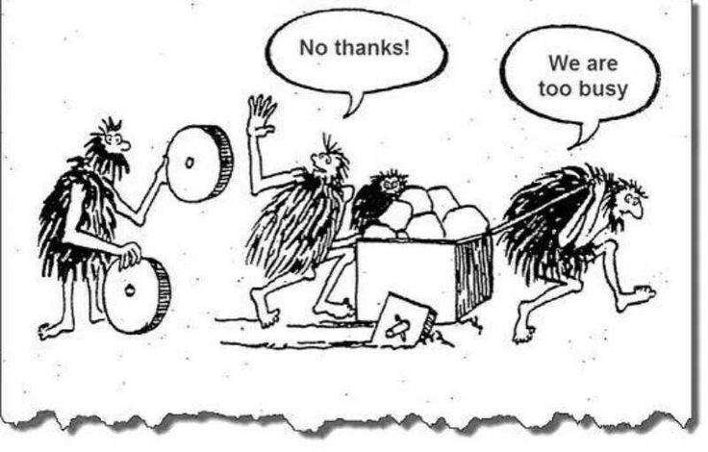

Slide 22
DIARY NOTES
Seriously, do we have to document every little thing?

Slide 23
Still need more reason to take diary notes and overall recordkeeping requirements seriously?
Per Federal Highway Administration/Code of Federal Regulations, 23 CFR 710.201 STATE RESPONSIBILITIES, Subpart B – Program Administration...
(f) Recordkeeping. The acquiring agency shall maintain adequate records of its acquisition and property management activities.
(1) Acquisition records, including records related to owner or tenant displacements, and property inventories of improvements acquired shall be in sufficient detail to demonstrate compliance with this part and 49 CFR part 24. These records shall be retained at least 3 years from either:
The date the State receives Federal reimbursement of the final payment made to each owner of a property and to each person displaced from a property, or
The date a credit toward the Federal share of a project is approved based on early acquisition activities of the State.
(2) Property management records shall include inventories of real property considered excess to project needs, all authorized uses of airspace, and other leases or agreements for us of real property managed by the STD.

Slide 24
DIARY NOTES ARE NOT OPTIONAL See REPM / Sub-Section 3.1.5 Formal Negotiations
Diary
Notes

Slide 25
Per the REPM/Sub-Section 3.1.5 Formal Negotiations
Negotiation Diary (RE2058) - The purpose of the Negotiation Diary (RE2058) is to present a clear picture or story of what transpired during the negotiation of the particular parcel or land being acquired. The Negotiation Diary (RE2058) must document ALL discussions with property owners and any others associated with the parcel as well as discussions with other department staff or management. Pay particular attention to the "remarks" section. In the event of disputes, litigation, audits or other future situations, such documentation will serve as a reference and clearly “tell the story” to those who may not have been involved in the actual acquisition discussions. Number and date each separate entry and indicate who made the contact. Use at least the first initial and full last name of person making the entry. In the case of the parcel's main Real Estate agent, the full name only needs to be entered once. Initials will suffice for the remaining entries. WisDOT Real Estate staff and consultants are required to use the READS system to generate diaries. Timely, accurate and detailed entries are critical. One technique that can work for remembering details is to immediately record key points of the negotiation on a portable recording device for later review; this can prove to be useful when updating diaries.

Slide 26
WE HAVE FOUR RE DIARY FORMATS
See REPM / Forms: http://wisconsindot.gov/Pages/doing-bus/eng-consultants/cnslt-rsrces/re/repm-forms.aspx
Note: While this presentation focuses heavily on diary notes involving negotiations and the acquisition agent, we actually have four different diary formats. All are READS templates, which means information must be entered directly into and generate from READS.
Our diary formats are:
Land Inventory Diary (RE1047 - READS template)
Litigation Diary (RE1957 - READS template)
Negotiation Diary (RE2058 - READS template)
Relocation Assistance Diary (RE1043 - READS template)

Slide 27
DIARY NOTES
While an email trail can be useful, it does NOT replace diary notes!!!
EMAIL

Slide 28
LITIGATION
THERE CAN BE A WIDE VARIETY OF REASONS WHY PROPERTY OWNERS BRING SUIT AGAINST WISDOT

Slide 29
LITIGATION & DIARY NOTES
IN THE EVENT OF LITIGATION, DIARY NOTES SERVE AS A CRITICAL REFERENCE TO HELP TELL THE STORY
Diary Notes ~~~~~~ ~~~

Slide 30
DIARY NOTES
PUTTING TOGETHER AND UNDERSTANDING THE FULL STORY CAN HELP DURING LATER NEGOTIATIONS, MEDIATION AND A JURY TRIAL

Slide 31
by Kathy Curren
April 4, 2012
See: additional/supplemental detailed notes
SUMMARY DISCUSSION POINTS
As per the Real Estate Program Manual (REPM), under 3.1.5 Formal Negotiations, “The purpose of the diary is to present a clear picture or story of what took place during negotiations.”
All WisDOT staff and consultants are required to use READS to generate diaries.
Timely, accurate, and detailed entries are critical.
The following shall be documented:
All discussions and meetings with property owners.
All discussions and meetings with any parties of interest.
All discussions and meetings with management and other staff including what was decided/not decided. In the event of disputes, litigation, audits, or other future situations, such documentation will serve as a reference to clearly tell the story.
Note who attended and what was discussed.
An email trail does not replace diary notes. An email trail can be included in the file, but a summary of what occurred is needed in the READS diary notes.
It would be helpful to know if there have been other negotiations with the same property owner and whether or not there was an agreement. This may be especially useful if/when defending the department in litigation.
If more money is expected, note how much more the property owner thinks they are entitled to and what they are basing that amount on. This is helpful to the department during mediation.
Note whatever issues the property owner has concerns about.

