Slide 1
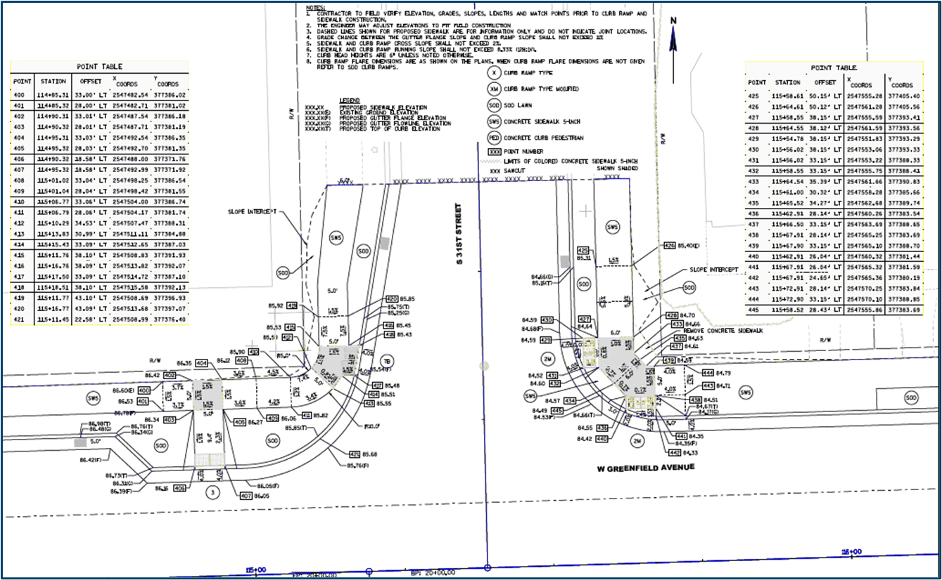
Curb Ramp Construction Documentation
Before Construction Project Begins
Review Curb Ramp Construction Details
Have designer correct any errors/issues that are found
If curb ramp has technical infeasibility
Have designer explain any technical infeasibility issues if there are questions
Discuss Curb Ramps with contractor at the Construction Precon meeting
Chance to answer any curb ramp related questions in advance of construction

Slide 2
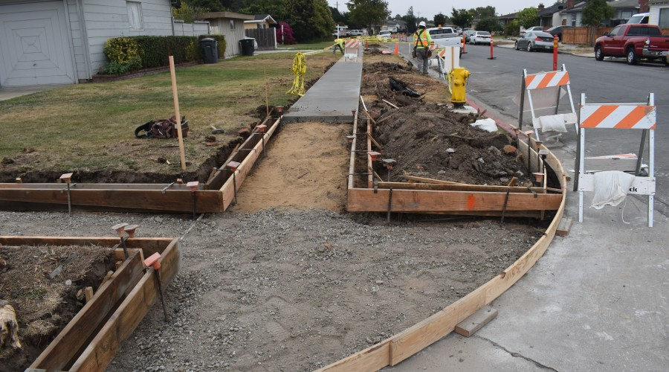
Curb Ramp Construction Documentation
Before Curb Ramp Construction Begins
Review sidewalk and flange line match elevations
If elevations differ from plan elevations, have designer review differences and adjust curb ramp construction details accordingly
Verify curb ramp dimensions, slopes and elevations once forms are placed
This should be done prior to placing concrete
Address any errors that are identified
Have designer address issues

Slide 3
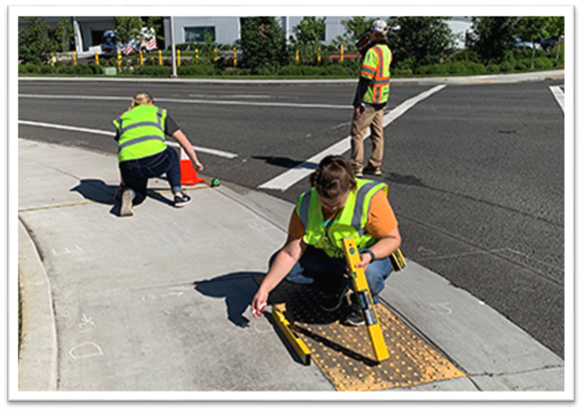
Curb Ramp Construction Documentation
After Curb Ramp Construction
Measure curb ramp components
Record data using the Post Construction Curb Ramp Compliance Form
Make sure to fill out the Post Construction Curb Ramp Compliance Report
Fill out form once concrete has cured
If non-compliance components found
Notify contractor immediately
Check for Technical Infeasibility that was not known about

Slide 4
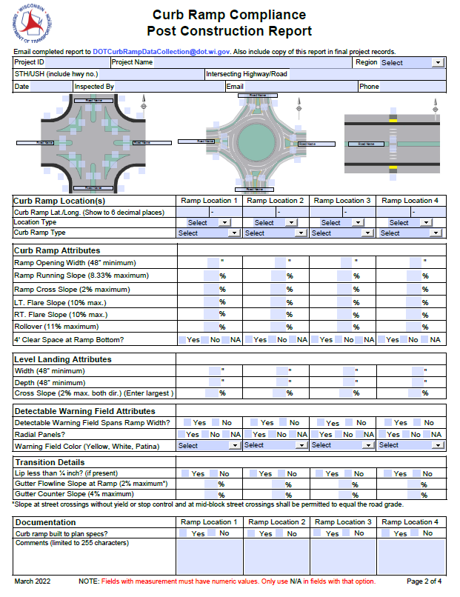
Curb Ramp Construction Documentation
Filling out Post Construction Compliance Report
Check Pantry to get current version of the form
Make sure Lat./Long. is shown to 6 decimal places
Do not use N/A for any data fields
If curb ramp not built to plan specs, make sure to document what was done and why it was done in the space provided in the form
Information entered into WisDOT GIS database
Used to help navigate

